Slide 1
Chamber of Forest Engineers of Türkiye
2024

Slide 2
Chamber of Forest Engineers of Türkiye (OMO)-Legal Base
OMO, a non-profit NGO, was established on 4 February 1954 within the framework of "the Law on Turkish Union of Chambers Engineer and Architect (TMMOB), Numbered 6235”.
OMO is a corporate body and a professional organization defined in the form of a public institution as stated in the Article 135 of the Constitution. OMO also has public legal entity.
ARTICLE 135 of Turkish Constitution as follows- “Professional organizations having the characteristics of public institutions and their higher bodies are public corporate bodies established by law, with the objectives of meeting the common needs of the members of a given profession, to facilitate their professional activities, to ensure the development of the profession in keeping with common interests, to safeguard professional discipline and ethics in order to ensure integrity and trust in relations among its members and with the public; their organs shall be elected by secret ballot by their members in accordance with the procedure set forth in the law, and under judicial supervision- https://global.tbmm.gov.tr/docs/constitution_en.pdf

Slide 3
Chamber of Forest Engineers of Türkiye (OMO)-Legal Base
Beside the Foundation Law, there is another Law No. 5531 entitled “The Law on Forest Engineers, Forest Industrial Engineers and Woodworking Industrial Engineers.” dated July 8, 2006.
According to this Law, OMO is the legal representative of three different professional groups as follows:
Forest Engineers,
Forest Industrial Engineers, and
Woodworking Industrial Engineers.
Currently the Chamber of Forest Engineers has about 20 thousand active members.

Slide 4
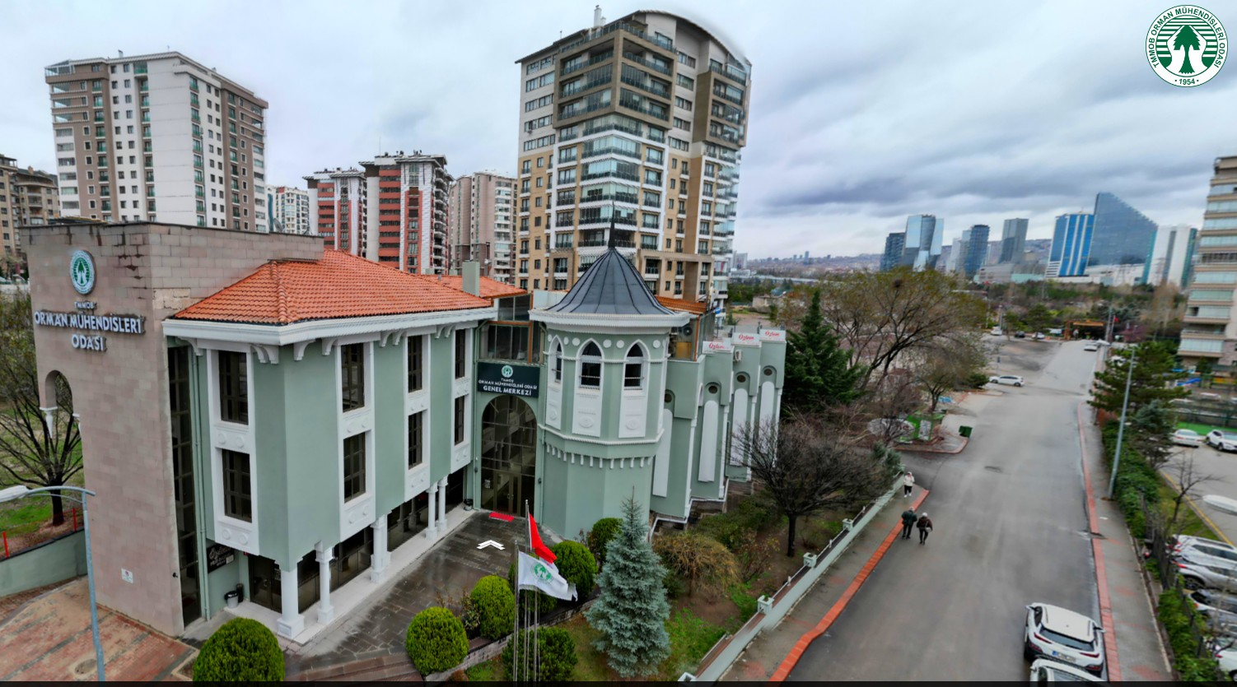

Slide 5
Chamber of Forest Engineers of Türkiye (OMO)-Legal Base
A large number of its members work in forestry related departments of the Ministry of Agriculture and Forestry (MoAF) specifically in the General Directorate of Forests and the General Directorate of Nature Conservation and National Parks,
In addition, there are members working in public institutions such as;
General Directorate of Combating Desertification and Erosion of the Ministry of Environment, Urbanization and Climate Change,
General Directorate of State Hydraulic Works of MoAF and
General Directorate of Highways of the Ministry of Transport and Infrastructure.
On the other hand, there are members working in their own workplace and working in private sector companies. As of today, there are approximately 1500 offices and companies operating under the occupational law no. 5531 under the coordination of OMO.

Slide 6
Mandates of OMO's National and International Activities
"OMO Main Regulation", prepared based on the Establishment Law, was published in the Official Gazette dated 12 July 2006.
Based on this Main Regulation, "OMO Foreign Relations Service Working Principles and Procedures" was prepared and entered into force in 2011.
OMO carries out its national and international activities within the framework of these two laws, main regulations, communiqués and the decisions of the current Board of Directors. https://www.ormuh.org.tr/odamiz/yonetim-kurulu

Slide 7
OMO's National and International Collaborations
OMO cooperates closely and based on written principles with the;
Presidency and the Turkish Grand National Assembly, as well as with all Ministries, including;
the Ministry of Agriculture and Forestry,
the Ministry of Environment, Urbanization and Climate Change,
the Ministry of Foreign Affairs,
the Ministry of Industry and Technology,
Ministry of Culture and Tourism and the Ministry of National Education.
With the institutions of the United Nations, especially FAO,
With the secretariats of international agreements, especially the Rio Conventions,
Directly with countries, especially FAOSEC Countries and countries such as Bosnia-Herzegovina, Moldova and Romania,
With national, international and non-governmental organizations in other countries based on written agreements. https://world.ormuh.org.tr/membership/

Slide 8
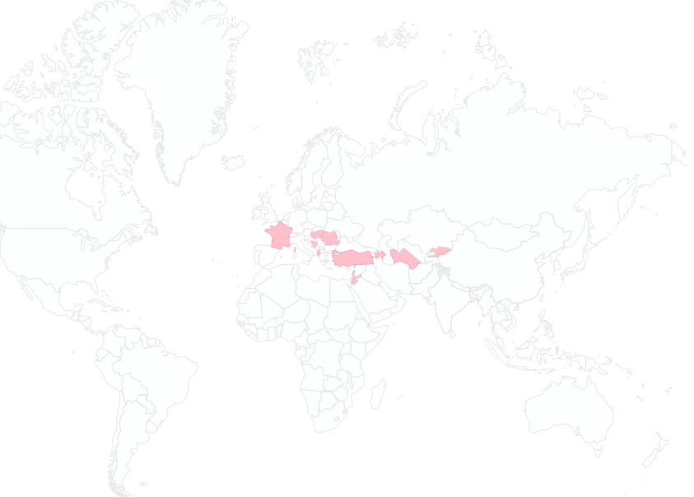
Countries of NGOs with which OMO has a Cooperation Agreement

Slide 9
No | Ülke Adı | Name of the NGO-English | Web Page | Date/Year
1 | Albania | ALBAFOREST CENTER | www.albaforest.com | 2018
2 | Azerbaijan | Natural Wealth and Ecology Workers Trade Union Republic Committee | http://ahik.org | 208
3 | Bosnia | Beekeepers Union of Sarajevo |  | 2018
4 | Bosnia | Forestry Association of Federation of Bosnia and Herzegovina | http://usitfbih.ba/ | 2018
5 | Bosnia | The Association of Hunting Organizations in Bosnia and Herzegovina | http://www.slobih.ba/ | 2018
6 | Bosnia | The Independent Trade Union of Forestry, Wood Processing and Paper of Bosnia and Herzegovina- | http://ssspdp.ba/ | 2018
7 | France | The International Association for Mediterranean Forests (AIFM) | https://aifm.org/en/home/ | 2018
8 | Hungary | The Trade Union of Forestry and Wood Industry Workers | http://efdsz.hu/ | 2018
9 | Kyrgyzstan | CAMP Alatoo Public Foundation | http://en.camp.kg/ | 2022
10 | Kyrgyzstan | KYRGYZ ASSOCIATION OF FOREST AND LAND USERS | http://www.landuse-association.kg/ | 2018
11 | Kyrgyzstan | National pasture users’ Association of Kyrgyzstan “Kyrgyz Jayity” | http://www.jayit.kg/en/ | 2022
12 | Lebanon | Lebanon Reforestation Initiative | https://www.lri-lb.org/ | 2022
13 | Poland | FOREST FRIENDS ASSOCIATION of POLAND | http://tpl.org.pl/ | 2022
14 | Romania | SILVA TRADE UNION FEDERATION | https://federatiasilva.ro/ | 2018
15 | Romania | The “Forest Progress” Society | http://progresulsilvic.ro/ | 2018
16 | Belgium | The Union of European Foresters | https://european-foresters.eu/ | 2015
17 | Romania | The Council of European Foresters | http://www.ceforg.eu/ | 2015
18 | India | Gram Bharati Samiti-Society for Rural Development | http://www.gbsjaipur.org/ | 2023

Slide 10
Some national memberships and initiatives
OMO is a member of the "National Biodiversity Coordination Board" established by the Presidential Circular published in the Official Gazette dated 2 August 2019.
OMO is accredited as a Personnel Certification Body by the Turkish Accreditation Agency
OMO supported the preparation of National Development Plan 2024-2028
OMO drafted the National Watershed Rehabilitation Strategy

Slide 11
Some Major International Conferences Organized by OMO
2-5 December 2018,
International Symposium on the “Role of Public-Civil Society-Private Sector Cooperation and International Partnerships in Achieving Sustainable Development Goals and Global Forest Goals.
4-7 November 2021
International Forests and Biodiversity Symposium
11-13 November 2022
Forest and Ecosystem Summit

Slide 12
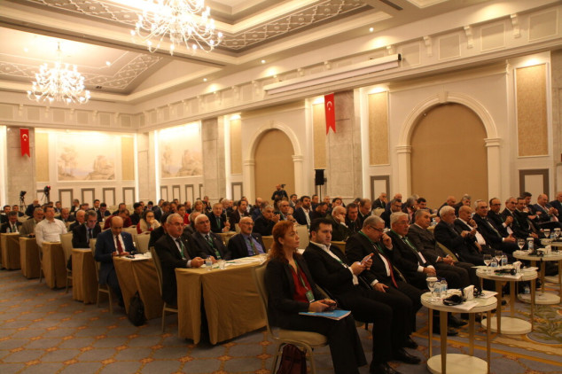
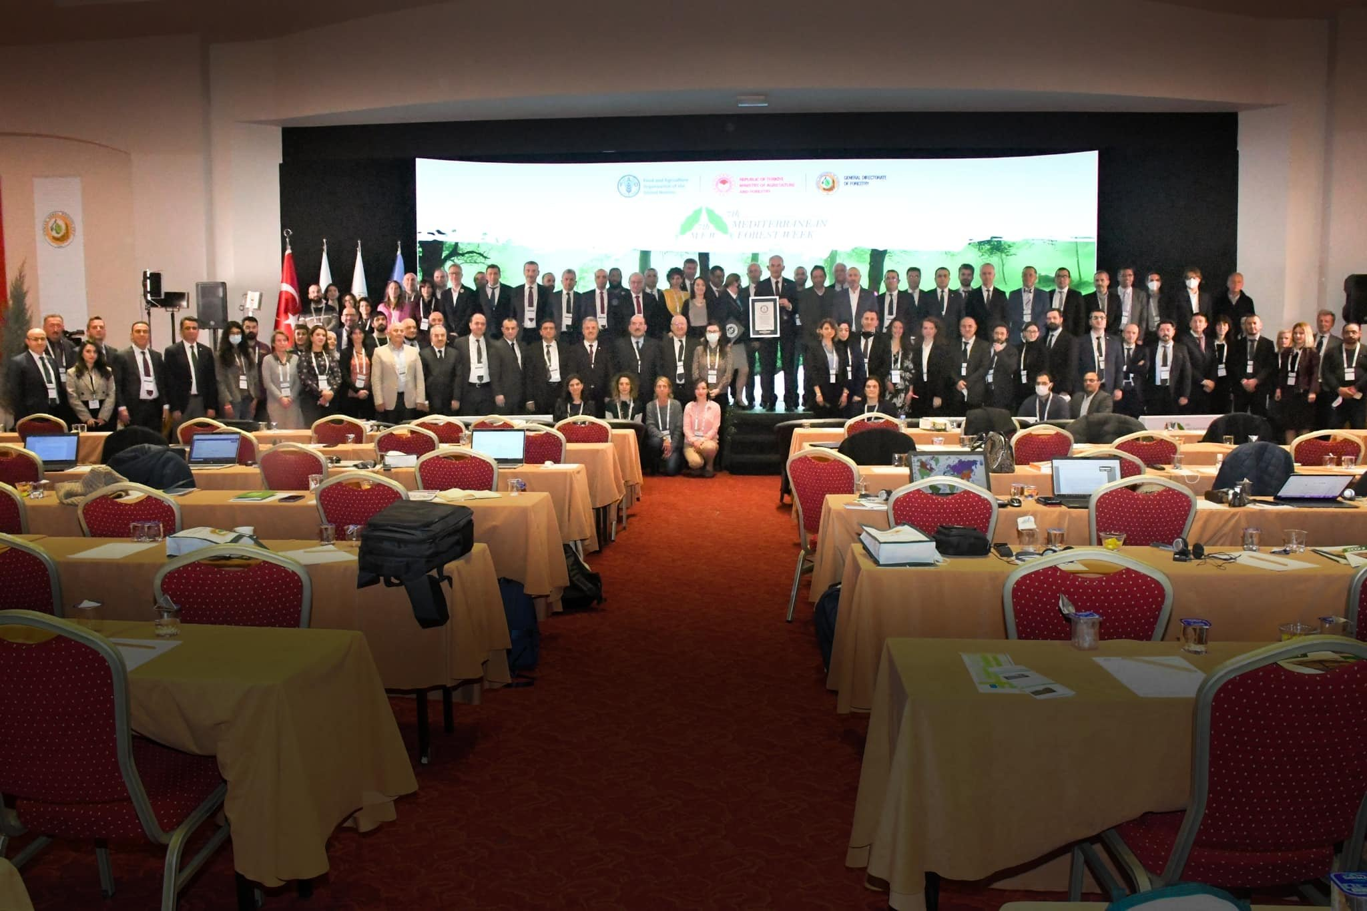
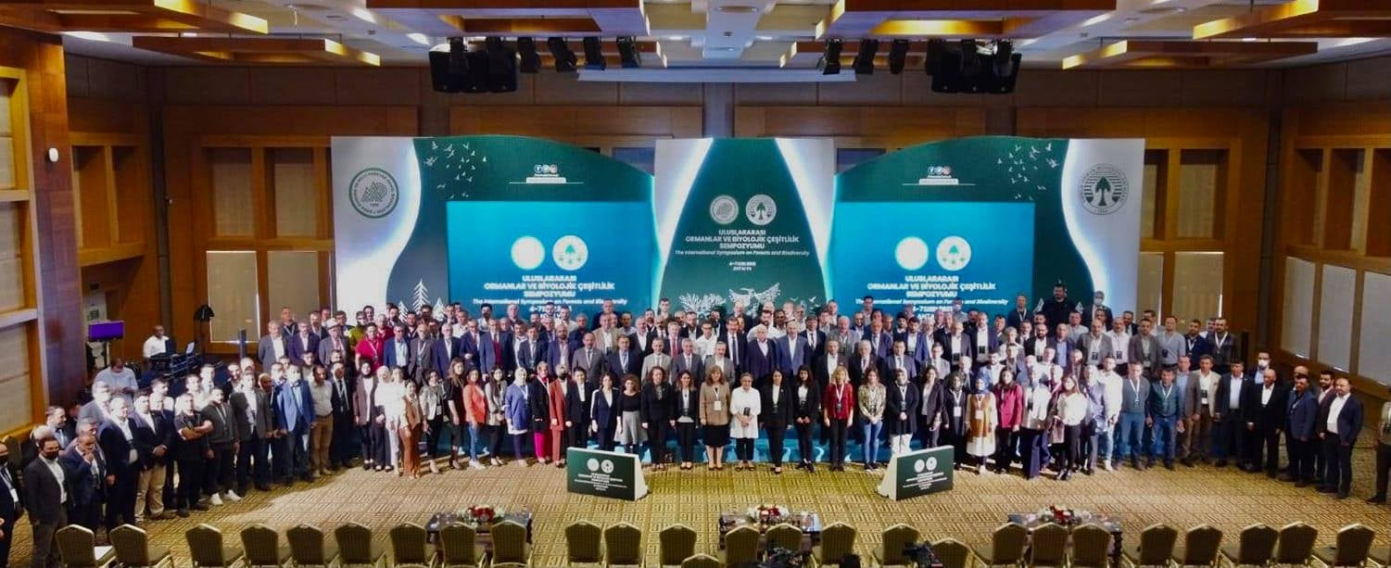

Slide 13
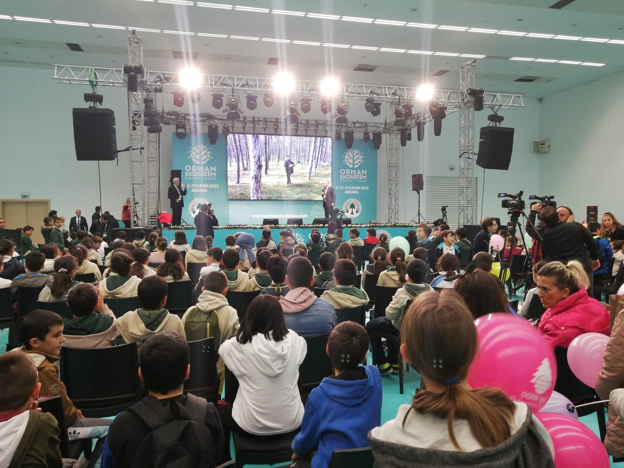
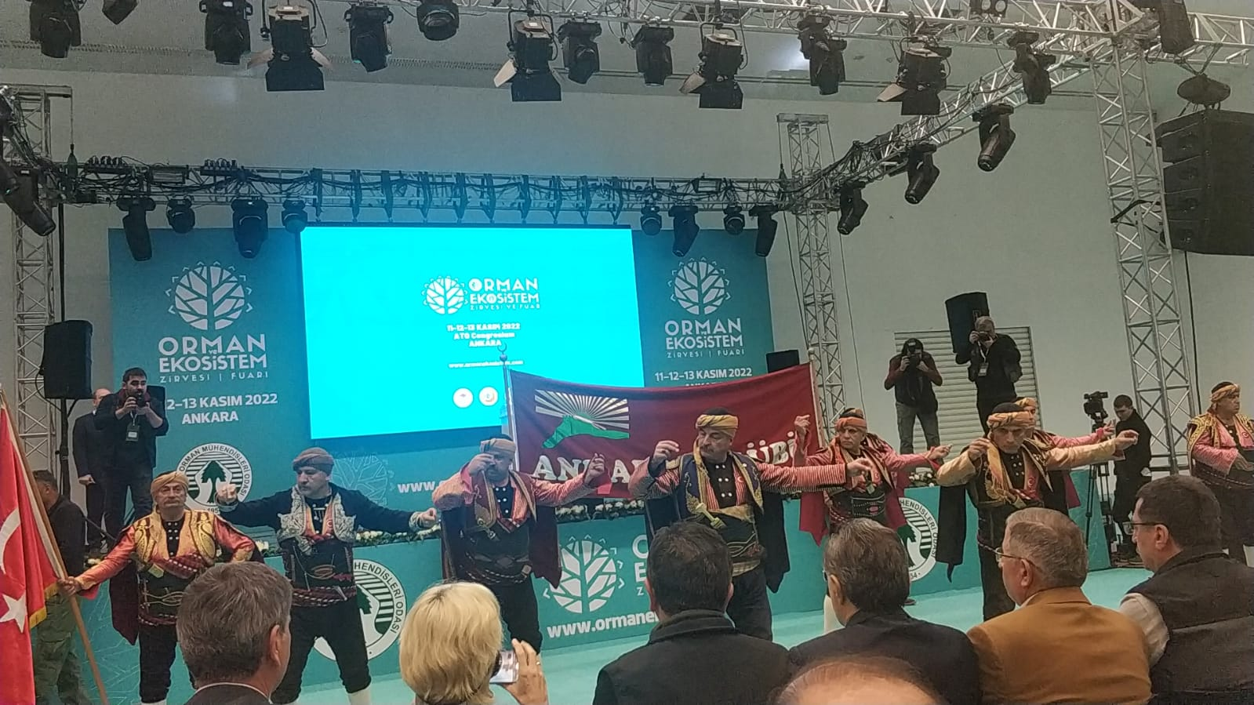
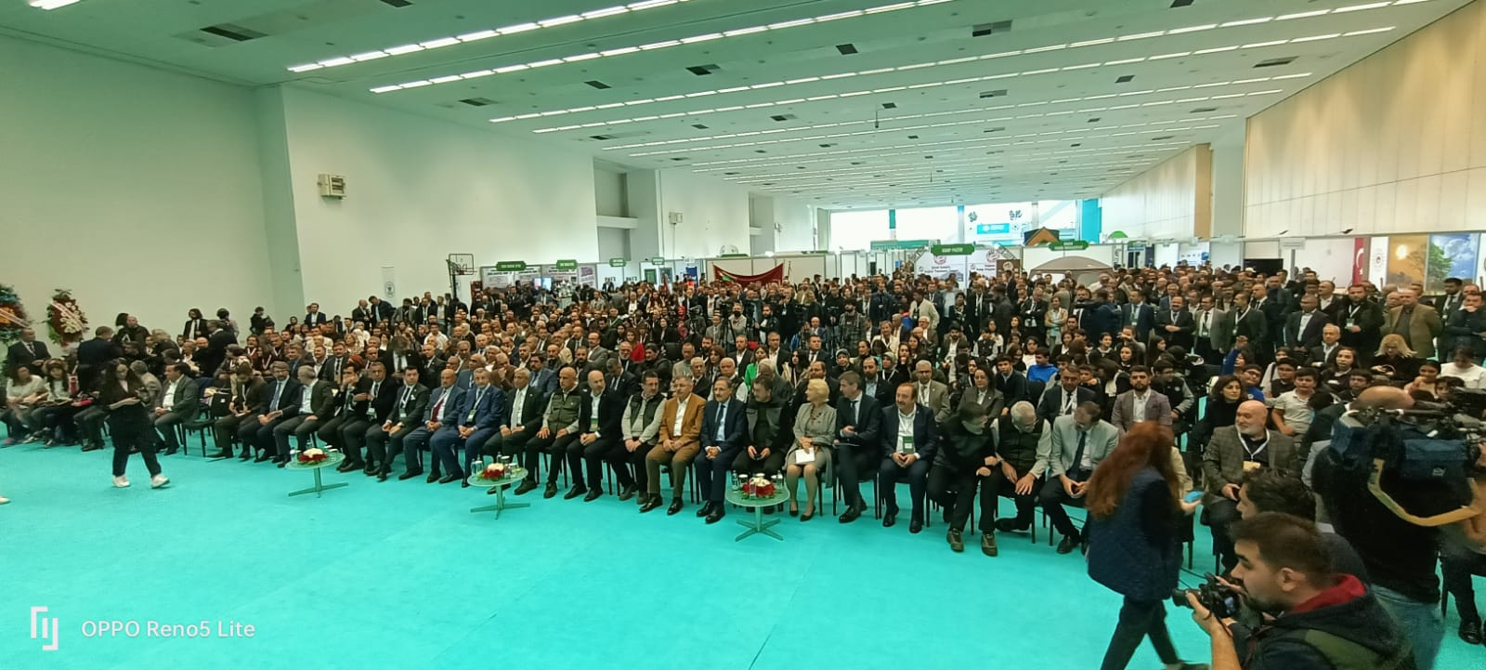

Slide 14
OMO-FAOSEC Cooperation
OMO has been working closely with FAO since 2019.
Within the scope of a total of 11 LoAs signed with FAO, OMO has completed the drafting of three projects.
Restoration of Degraded Forests and Other Lands
Strengthening the collaboration between FAO and MAF through enhancing of the capacity of the International forestry training center
Improving biodiversity and sustainable forestry
OMO contributed to the drafting of 2 World Bank projects, in total around 600 milllion USD.
Turkey Resilient Landscape Integration Project (TULIP)
Türkiye Climate Resilient Forests Project
OMO prepared four guidelines for FAO as follows:
Guidelines on Sustainable Management of Non-Wood Forest Products (NWFPs) ,
Guidelines on Sustainable Forest Management under the Impact of Climate Change in Central Asia ,
Guidelines on Safeguarding Native Tree Species for Conservation of Genetic Biodiversity in Central Asia ,
Guidelines on the Implementation of Nature-based Solutions (NBSs) to Combat Negative Impact of Climate Change on Forestry for Central Asia.
OMO carried out 9 international trainings.

Slide 15
No | Year | Name
1 | 2019 | Training Programme for Kyrgyz Participants for Forest Training Center in Antalya
2 | 2019 | Development of the draft of the full-fledged project document on ‘Restoration of Degraded Forests and Other Lands" -FRIENDS
3 | 2019 | Biophysical Data Assessment in support of Monitoring of the Restoration Activities under the Great Green Wall Initiative
4 | 2019 | Provision of Technical Guidelines on Sustainable Management of Non-Wood Forest Products (NWFPs) and the Status Reports on Specific Selected Products
5 | 2020 | “Conducting economic and social impact assessments for developing Feasibility Study and Environmental and Social Instruments for formulation and implementation of the Bolaman River Basin Rehabilitation Project”
6 | 2020 | “Conducting economic and social impact assessments for developing Feasibility Study and Environmental and Social Instruments for formulation and implementation of the Çekerek River Basin Rehabilitation Project”
7 | 2021 | “Development of the Guidelines on Sustainable Forest Management under the Impact of Climate Change in Central Asia including organization of a Conference on Climate Change Impact on Forests of Central Asia and development of the Guidelines on Safeguarding Native Tree Species for Conservation of Genetic Biodiversity in Central Asia including organization of the related Training workshop”
8 | 2021 | Preparation and implementation of training on fire management including development training desing and materials
9 | 2021 | “Development of the drafts of two full-fledged project documents on ‘Strengthening the collaboration between FAO and MAF through enhancing of the capacity of the International forestry training centre` and `Improving biodiversity and sustainable forestry` ”
10 | 2022 | Communication Services for at the 7th Mediterranean Forest Week (2-25 March 2022)
11 | 2023 | Development of the guidelines on the implementation of Nature-based Solutions (NbSs) to combat negative impact of climate change on forestry for the sub-region and providing associated training

Slide 16
/TmmobOrmuh
ormuh@ormuh.org.tr

Slide 17
For contact: ismailbelen52@gmail.com
WhatsApp: +90 506 222 48 19

