Slide 1

UNFF Approaches to Integrated Fire Management
İsmail Belen
Chair of the 20th Session, United Nations Forum on Forests (UNFF)
Aerial Fire Fighting Series: Global Conference and Exhibition
Rome, Italy | March 26, 2026

Slide 2

Introduction & Appreciation
TANGENT LINK
ITALIAN PATRONAGE
GLOBAL PARTNERSHIPS
Sincere appreciation for organizing the 28th edition of the Aerial Fire Fighting Conference.
Under the patronage of the Italian National Fire Service and the Global Fire Monitoring Centre.
Essential for strengthening international cooperation against the challenge of wildfires.

Slide 3

What is the United Nations Forum on Forests (UNFF)?
ESTABLISHMENT
MISSION
GLOBAL HUB
Established in 2000. The only universal intergovernmental policy platform on forests in the UN.
Promoting the management, conservation, and sustainable development of all types of forests.
Serves as the central global policy platform dedicated to international forest policy and cooperation.

Slide 4
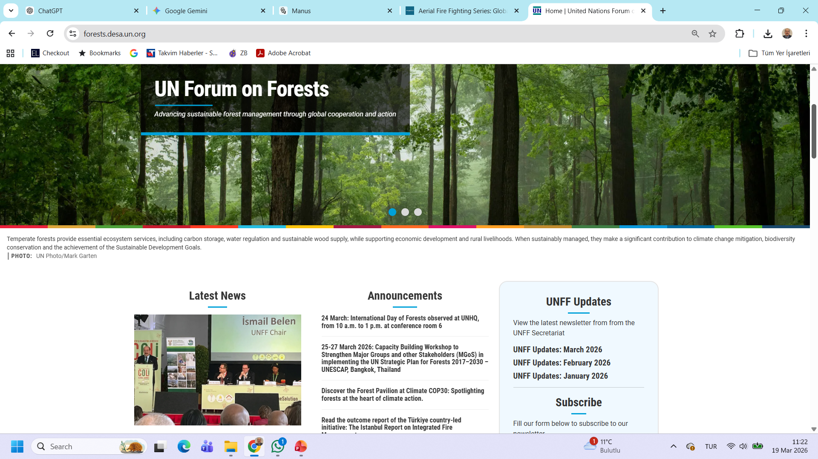

Slide 5
Strategic Framework: UN Strategic Plan for Forests 2017–2030
GLOBAL GOALS
2030 AGENDA
CORE VISION
Six Global Forest Goals guide international policy and cooperation towards sustainable management.
Directly contributes to the 2030 Agenda for Sustainable Development and global biodiversity goals.
A world where all forests contribute to economic, environmental, and social well-being.

Slide 6

A Pressing Global Challenge: Increasing Wildfires
DRIVING FACTORS
ECOSYSTEM IMPACT
POLICY SHIFT
Climate change, land degradation, and biodiversity loss are increasing fire frequency and intensity worldwide.
Unsustainable land-use practices are making landscapes more vulnerable to extreme wildfire events.
Wildfire management has evolved from a technical issue to a central global policy and ecological priority.

Slide 7

Global Policy Shift: Key Milestones (2023-2024)
INDIA CLI (2023)
PORTO CONFERENCE (2023)
UNFF RECOGNITION (2024)
Country-Led Initiative on forest fires, certification, and sustainable management to exchange global experiences.
8th International Wildland Fire Conference: Adoption of Integrated Fire Management (IFM) as a key approach.
The Forum formally recognized the importance of strengthening international cooperation on IFM approaches.

Slide 8
Global Cooperation & G7 Process (2024-2025)
ROME G7 EVENT
KANANASKIS CHARTER
FAO GLOBAL FIRE HUB
October 2024: "Forests for the World" event brought wildfire management to the G7 agenda.
Canada 2025: First high-level political commitment to strengthen global capacity against extreme wildfires.
A game-changing platform for knowledge sharing, early warning, and capacity building worldwide.

Slide 9
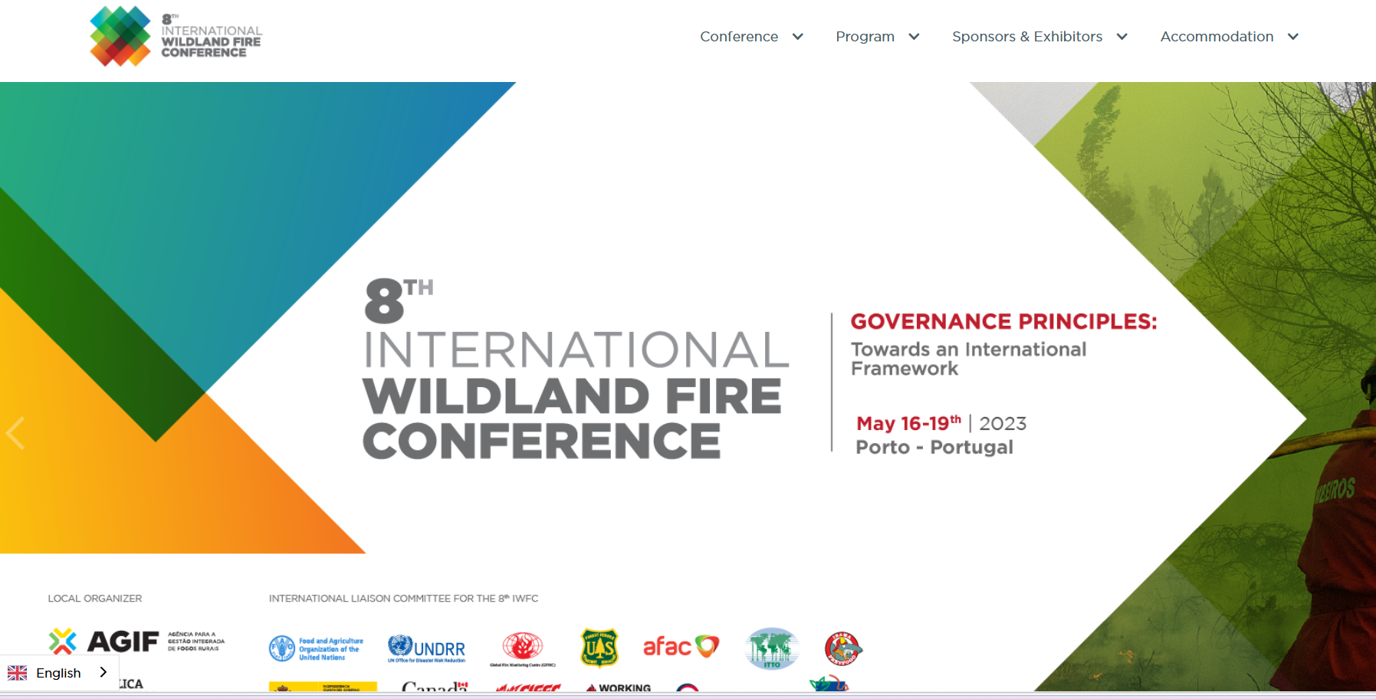
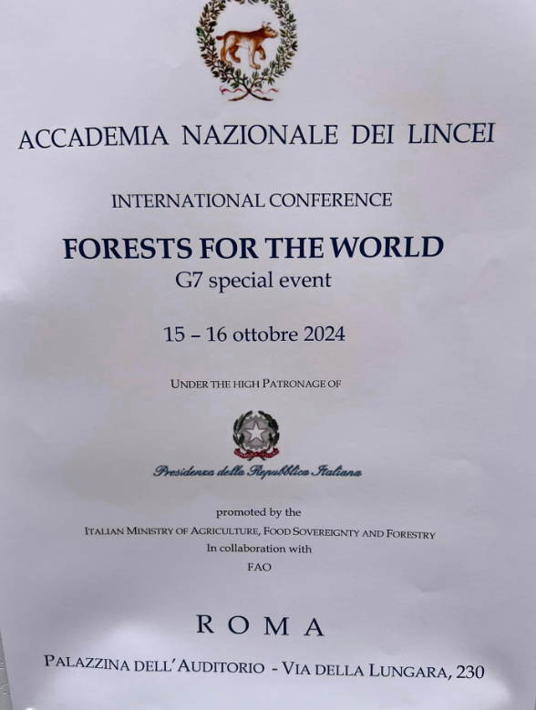
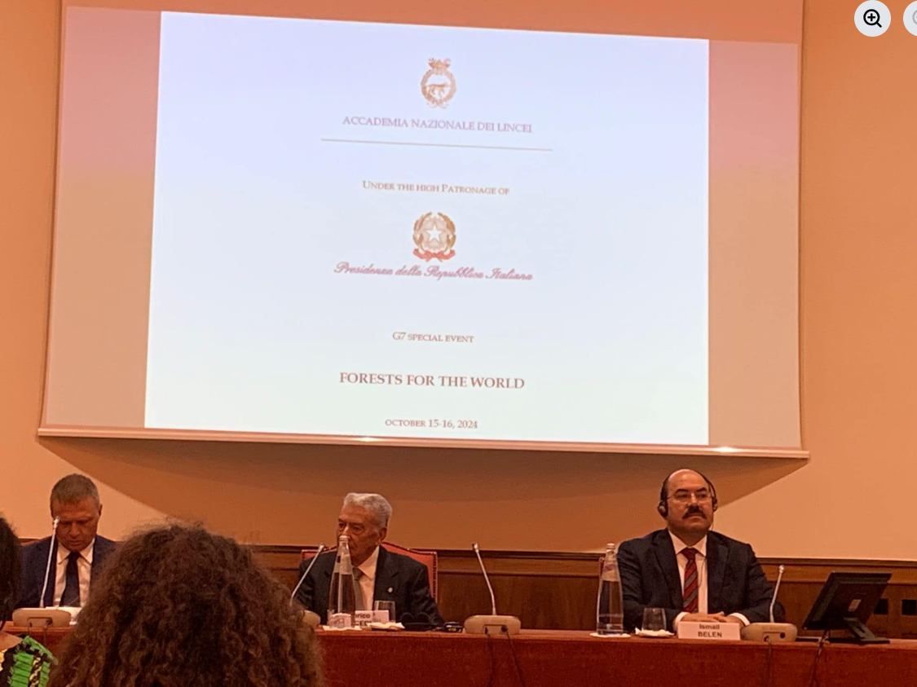

Slide 10

Türkiye’s Role: The Istanbul Report
The Country-Led Initiative (CLI) held in Istanbul (Oct 2025) established a new roadmap for Integrated Fire Management.
HOLISTIC FRAMEWORK
CAPACITY BUILDING
GLOBAL DIALOGUE
Integrated strategies combining prevention, preparedness, response, and recovery.
Strengthening knowledge sharing, technology transfer, and early warning systems globally.
Concrete policy recommendations within the framework of UNFF and international processes.

Slide 11
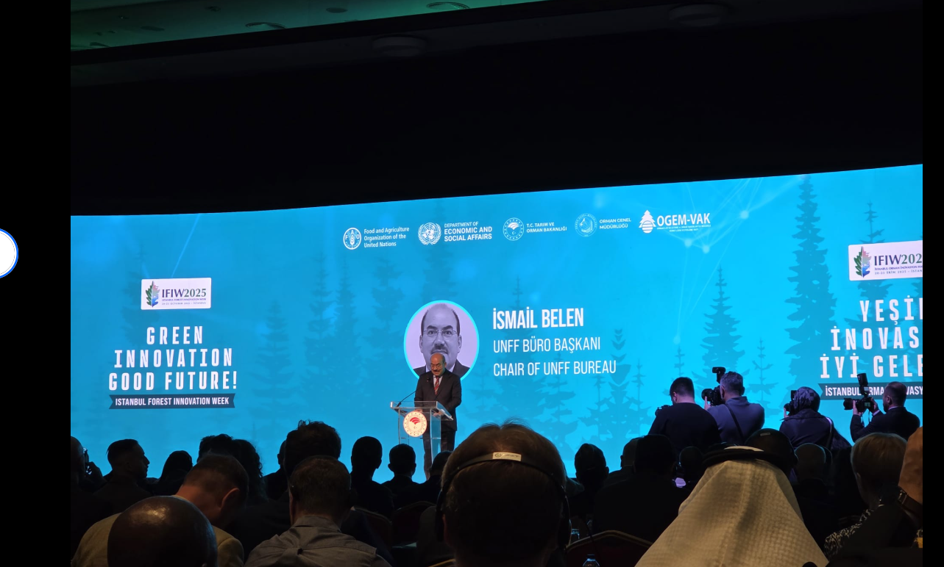
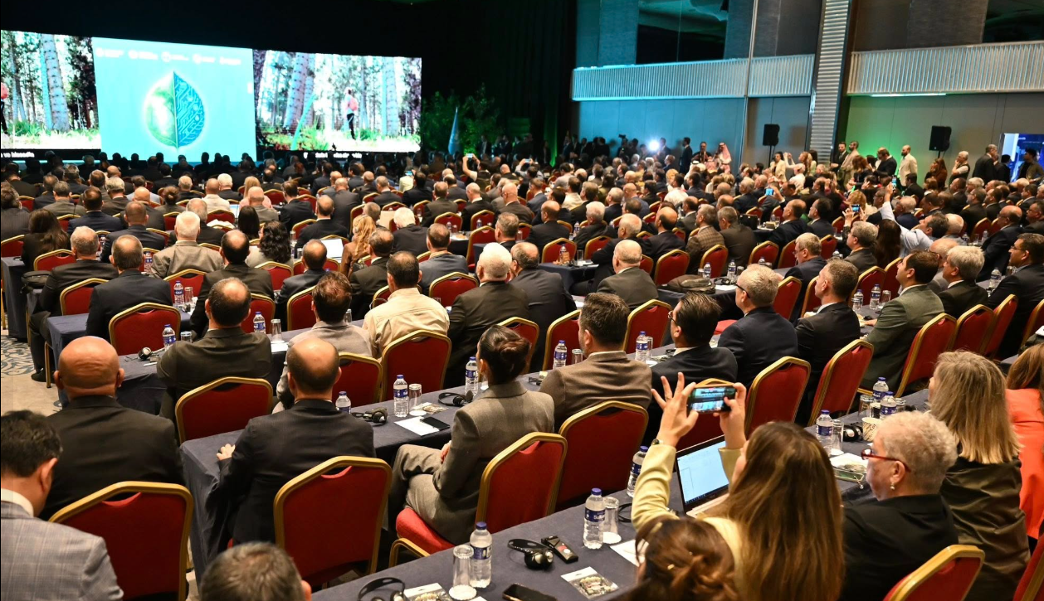
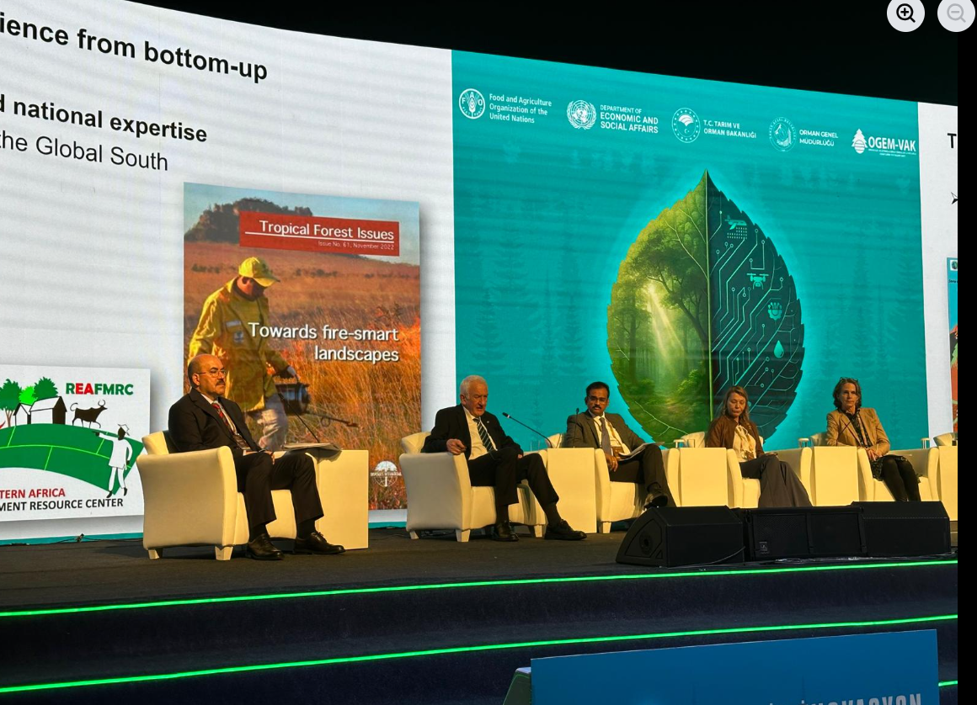
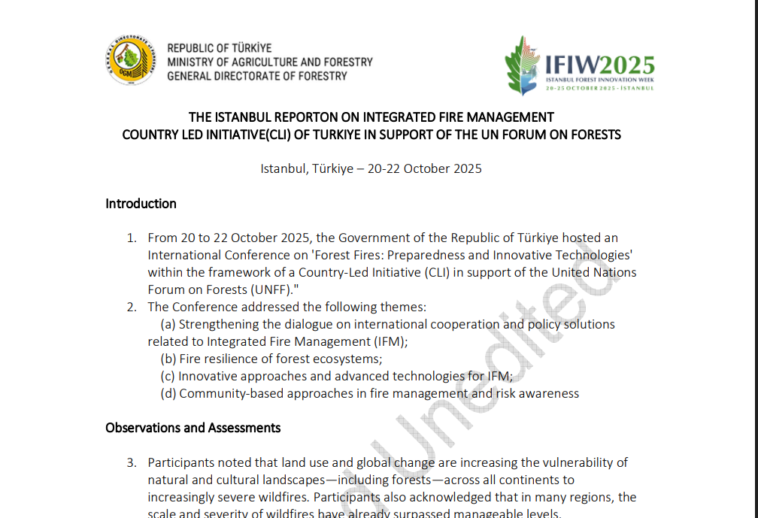

Slide 12

Global Action: COP30 & UNEA Resolutions
COP30 BELÉM (2025)
UNEA RESOLUTION
INSTITUTIONAL SYNERGY
Launch of a major "Call to Action" to combat deforestation and wildfires, valuing standing forests.
Landmark resolution (Dec 2025) on strengthening global wildfire management and IFM approaches.
Official recognition of contributions from UNFF, FAO, UNEP, and the Global Fire Management Hub.

Slide 13
Future Vision: 2026 Objectives
Accelerating the implementation of global forest commitments through strategic international milestones.
UNFF21 (MAY 2026)
COP31 (NOV 2026)
CAPACITY BUILDING
New York: Strengthening policy guidance and accelerating global forest commitments.
Antalya, Türkiye: Hosting the UN Climate Change Conference in a fire-sensitive region.
International Forestry Training Center in Antalya playing a key role in global wildfire management training.

Slide 14
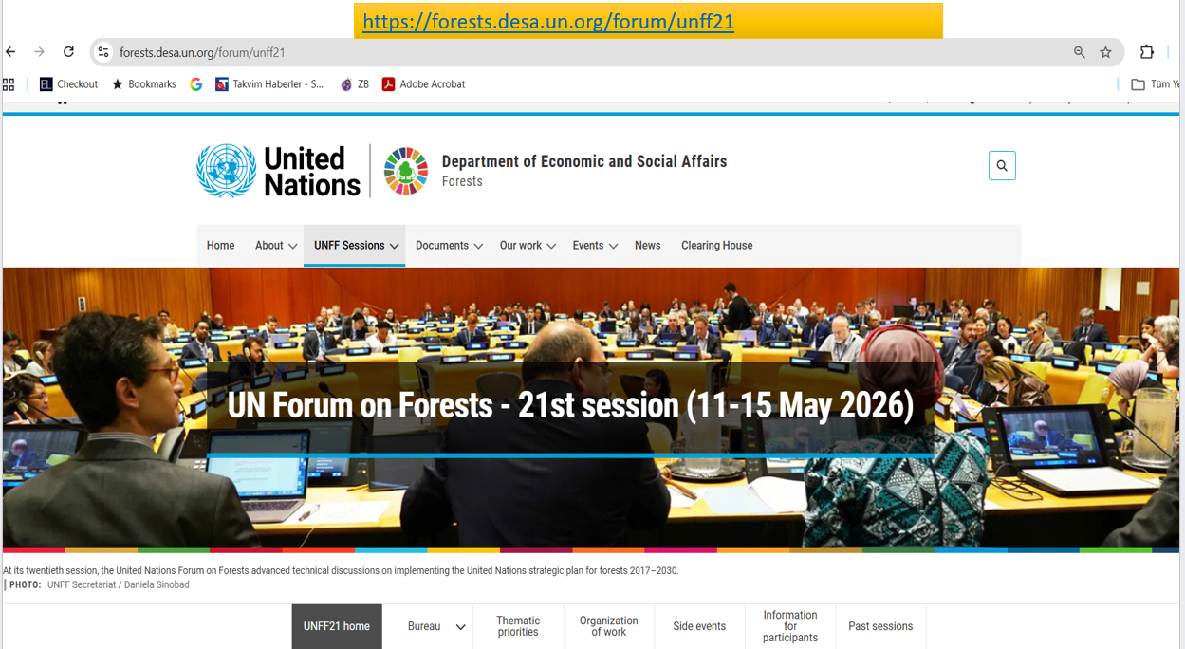

Slide 15

Integrated Approach: Balancing Technology & Ecology
Wildfire management must bridge technological innovation with a deep ecological understanding of entire ecosystems.
ECOLOGICAL PERSPECTIVE
HERITAGE PROTECTION
OPERATIONAL AWARENESS
Moving beyond technical solutions to account for biodiversity, wildlife, and natural habitats.
Integrating the preservation of cultural and archaeological heritage into fire management strategies.
Ensuring pilots and ground teams integrate ecosystem awareness into their daily operational work.

Slide 16

Conclusion: Acting Together for a Resilient Future
"In the face of increasing wildfire risks, we cannot act in isolation—we must act together."
GLOBAL SOLIDARITY
PRIVATE SECTOR ROLE
SUSTAINABLE LEGACY
Wildfires are a global risk requiring coordinated policy frameworks and effective international cooperation.
Active engagement of the private sector with UN, FAO, and UNFF initiatives is essential for global outcomes.
Building resilient landscapes to ensure a safer and more sustainable world for present and future generations.

