Slide 1

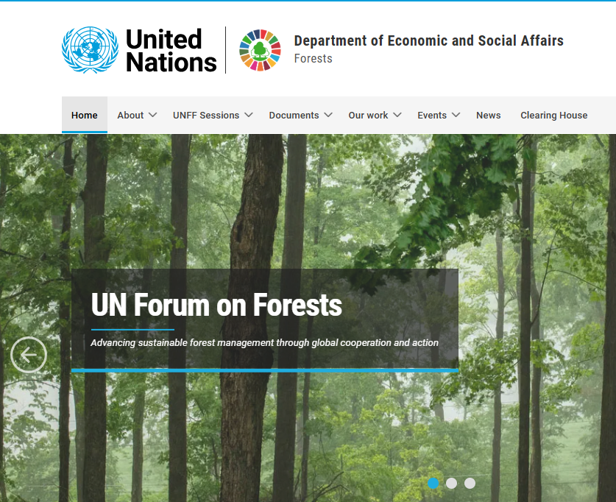
International Forum
“Dialogue for Sustainable Green Development: Investing in a Shared Future”
30 March 2026, Tashkent, Uzbekistan
“Barqaror yashil rivojlanish uchun muloqot: umumiy kelajakka investitsiya” xalqaro forumi
2026-yil 30-mart, Toshkent, O‘zbekiston
Remarks by İsmail Belen
Chair of the Bureau of the United Nations Forum on Forests
Ismoil Belenning nutqi
Birlashgan Millatlar Tashkilotining O‘rmonlar bo‘yicha forumi byurosi raisi

Slide 2
About İsmail Belen/İsmail Belen haqida qisqacha ma’lumot
A professional forester with around 35 years of experience.
Currently, I serve as:
  Chair of the United Nations Forum on Forests (UNFF) Bureau –https://forests.desa.un.org/
  Chief Inspector at the General Directorate of Forestry (OGM), Türkiye- https://www.ogm.gov.tr/en
  Chair of the Foundation Caring for Future (GONDER)
  https://gonder.org.tr/
  Advisor to the Chamber of Forest Engineers of Türkiye- https://www.ormuh.org.tr/
  Advisor to the Association of MDF and Chipboard Manufacturers- http://yomsad.org.tr/en/
Before:
  Senior Expert of the General Directorate of Nature Protection and National Parks- 2015-2022
  Deputy Director General of Desertification-2011-2015
  Deputy Director General of General Directorate of Forest-2007-2011
  Head of the Cabinet of the Ministry of Environmet-2005-2007
  Head of the Department of the General Directorate of Afforestation-2002-2005
  Chair of the Committee on Mediterranean Forestry Questions-Silva Mediterranea- https://www.fao.org/silva-mediterranea/en 2012-2017
  Member of the General Coordinating Committee of the Ministerial Conference on the Protection
  of Forests in Europe- https://foresteurope.org/ -2010-2011
Taxminan 35 yillik tajribaga ega professional o‘rmonchi.
Hozirda quyidagi lavozimlarda faoliyat yuritaman:
  Birlashgan Millatlar Tashkilotining O‘rmonlar bo‘yicha forumi (UNFF) byurosi raisi – https://forests.desa.un.org/
  Turkiya O‘rmon xo‘jaligi bosh boshqarmasida (OGM) bosh inspektor – https://www.ogm.gov.tr/en
  Kelajak uchun g‘amxo‘rlik jamg‘armasi (GONDER) raisi – https://gonder.org.tr/
  Turkiya O‘rmon muhandislari palatasi maslahatchisi – https://www.ormuh.org.tr/
  MDF va DSP ishlab chiqaruvchilari uyushmasi maslahatchisi – http://yomsad.org.tr/en/
Avval:
  Tabiatni muhofaza qilish va milliy bog‘lar bosh boshqarmasida katta ekspert – 2015–2022
  Cho‘llanishga qarshi kurash bosh direktor o‘rinbosari – 2011–2015
  O‘rmon xo‘jaligi bosh boshqarmasi bosh direktor o‘rinbosari – 2007–2011
  Atrof-muhit vazirligi apparati rahbari – 2005–2007
  O‘rmon barpo etish bosh boshqarmasi bo‘lim boshlig‘i – 2002–2005
  O‘rmon xo‘jaligi bo‘yicha O‘rta Yer dengizi masalalari qo‘mitasi (Silva Mediterranea) raisi – https://www.fao.org/silva-mediterranea/en 2012–2017
  Yevropada o‘rmonlarni muhofaza qilish bo‘yicha vazirlar konferensiyasi umumiy muvofiqlashtiruvchi qo‘mitasi a’zosi – https://foresteurope.org/ – 2010–2011

Slide 3
Forest and Economy-Sustainable Green Development: Investing in a Shared Future-
O‘rmon va iqtisodiyot – Barqaror yashil taraqqiyot: umumiy kelajak uchun sarmoya
Forests are not only environmental assets — they are strategic pillars of economic resilience, social stability and sustainable development.
Forests play a critical role in advancing all three pillars of sustainable development: economic, social and environmental.
  More than 1.6 billion people depend on forests
  The forest sector provides employment to over 40 million people globally
  Global trade in forest products has reached hundreds of billions of dollars annually
And yet: Forests remain undervalued in economic systems and underfunded in policy priorities.
At the same time, forests are at the center of global crises:
  Climate change
  Biodiversity loss
  Land degradation
  Desertification
  Water stress
O‘rmonlar faqat ekologik boylik emas — ular iqtisodiy barqarorlik, ijtimoiy barqarorlik va barqaror rivojlanishning strategik ustunlaridir.
O‘rmonlar barqaror rivojlanishning uch asosiy yo‘nalishi — iqtisodiy, ijtimoiy va ekologik — bo‘yicha muhim rol o‘ynaydi.
1,6 milliarddan ortiq inson o‘rmonlarga bog‘liq.
O‘rmon xo‘jaligi sohasi dunyo bo‘yicha 40 milliondan ortiq kishini ish bilan ta’minlaydi.
O‘rmon mahsulotlari bo‘yicha global savdo har yili yuzlab milliard dollarni tashkil etadi.
Shunga qaramay: o‘rmonlar iqtisodiy tizimlarda yetarlicha baholanmayapti va siyosiy ustuvor yo‘nalishlarda yetarli moliyalashtirilmayapti.
Shu bilan birga, o‘rmonlar global inqirozlarning markazida turibdi:
  Iqlim o‘zgarishi
  Biologik xilma-xillikning yo‘qolishi
  Yer degradatsiyasi
  Cho‘llanish
  Suv tanqisligi

Slide 4
FOREST FINANCE AND TRANSFORMATION NEED
O‘rmonlarni moliyalashtirish va tizimli transformatsiya ehtiyoji
One of the most critical issues we face today is forest finance.
Current global forest investment: ~USD 84 billion/year
Required investment: ~USD 300 billion/year
Annual gap: ~USD 216 billion
👉 This is not a small gap — it is a structural gap.
Closing this gap requires:
  Stronger international cooperation
  Public finance mobilization
  Innovative financial mechanisms
Including:
👉 Voluntary carbon markets
👉 Emissions Trading Systems (ETS)
👉 Biodiversity credits
👉 Blended finance models
Bugungi kunda duch kelayotgan eng muhim masalalardan biri — bu o‘rmonlarni moliyalashtirishdir.
Joriy global o‘rmon investitsiyalari: ~yiliga 84 milliard AQSh dollari
Zarur investitsiyalar: ~yiliga 300 milliard AQSh dollari
Yillik farq: ~216 milliard AQSh dollari
👉 Bu kichik farq emas — bu tizimli farqdir.
Ushbu farqni bartaraf etish quyidagilarni talab etadi:
  Kuchliroq xalqaro hamkorlik
  Davlat moliyasini safarbar qilish
  Innovatsion moliyaviy mexanizmlar
Jumladan:
👉 Ixtiyoriy karbon bozorlar
👉 Emissiya savdosi tizimlari (ETS)
👉 Biologik xilma-xillik kreditlari
👉 Aralash moliyalashtirish modellari

Slide 5
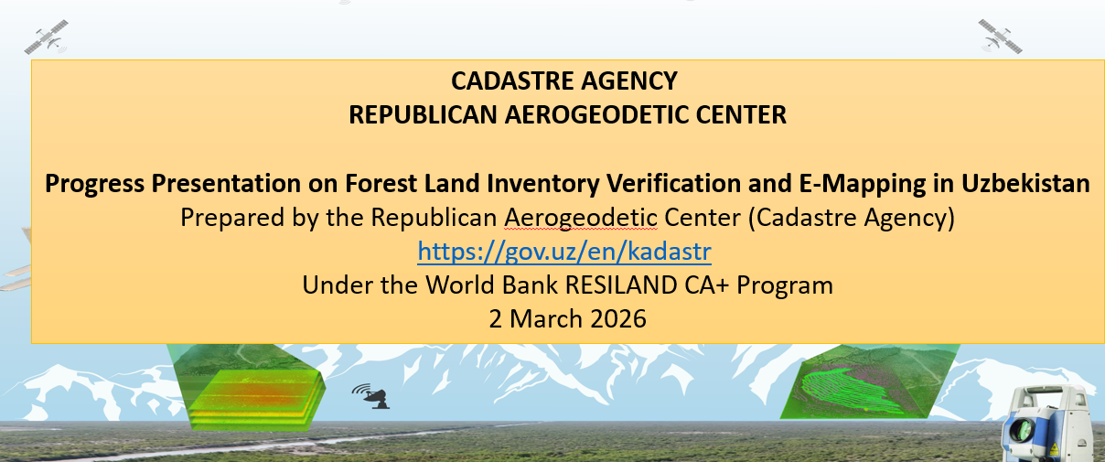
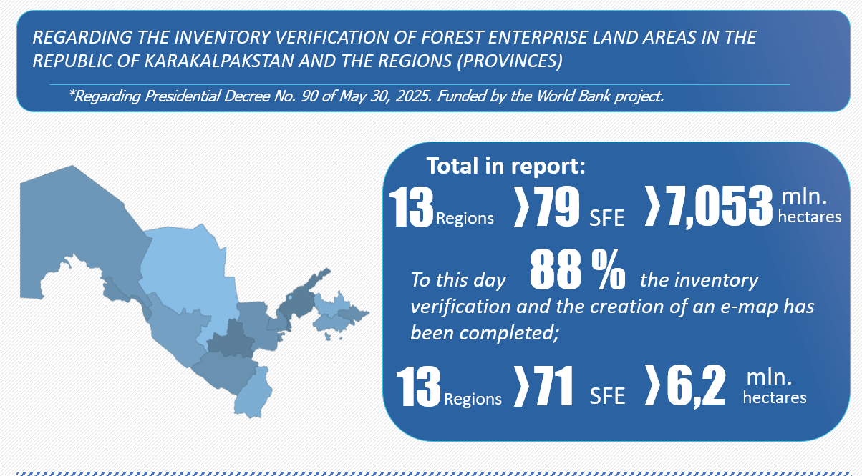
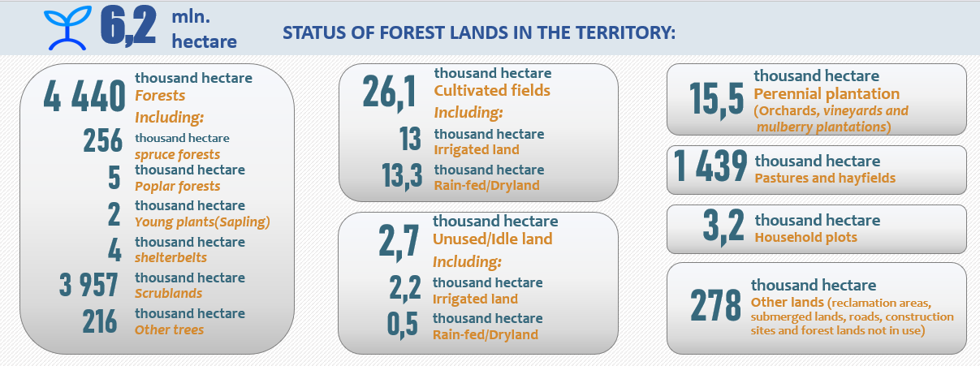
UZBEKISTAN: A COUNTRY WITH VISION AND MOMENTUM
O‘ZBEKISTON: ANIQ STRATEGIK TASAVVUR VA YUQORI SUR’ATGA EGA MAMLAKAT
As of 2026, Uzbekistan’s total land area is approximately 44.9 million hectares, of which 7.53 million hectares (16.8%) fall under the State Forest Fund.
Of this area, 6.2 million hectares (82%) have been cadastrally registered.
The country’s forest area is about 4.4 million hectares (9.8% of the total land area).
However, only 256 thousand hectares (5.8%) consist of coniferous (spruce) forests, while the vast majority—around 3.96 million hectares (90%)—are classified as scrublands.
2026-yil holatiga ko‘ra, O‘zbekistonning umumiy maydoni 44,9 million gektarni tashkil etadi, shundan 7,53 million gektari (16,8%) Davlat o‘rmon fondi tarkibiga kiradi.
Ushbu hududlarning 6,2 million gektarida (82%) kadastr ishlari yakunlangan.
Mamlakatning o‘rmon maydoni 4,4 million gektarni (9,8%) tashkil etadi.
Biroq, uning faqat 256 ming gektari (5,8%) ignabargli (ladin) o‘rmonlardan iborat bo‘lib, asosiy qismi — taxminan 3,96 million gektari (90%) butazor (scrubland) hududlardan tashkil topgan.

Slide 6
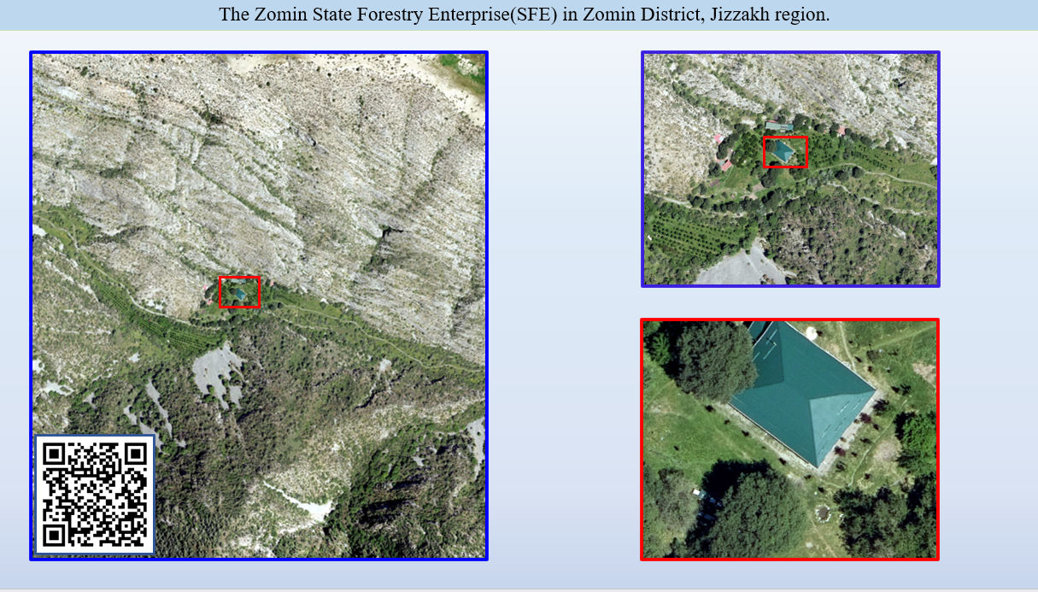

Slide 7
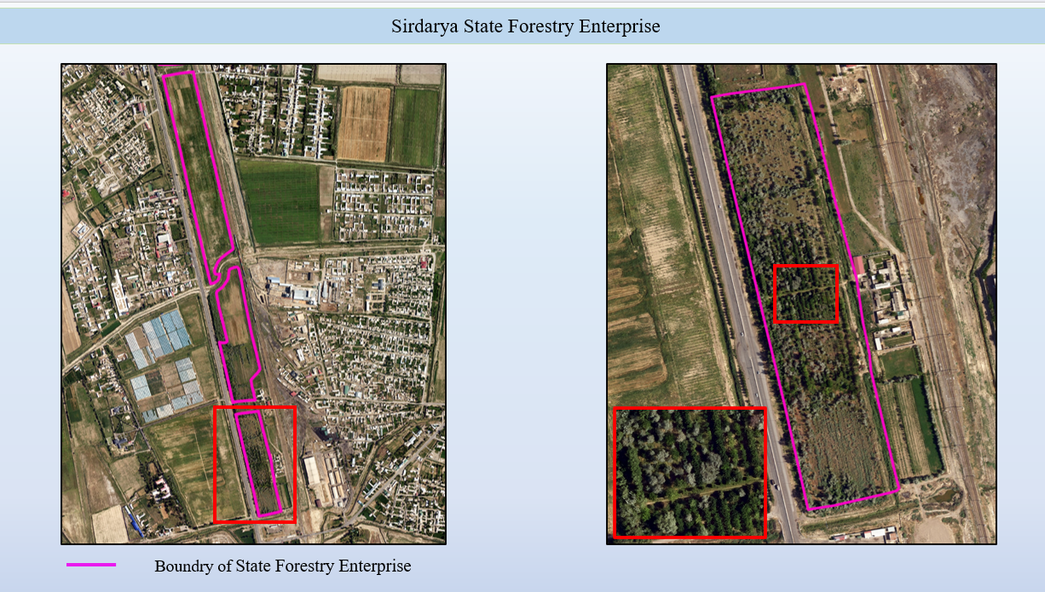

Slide 8
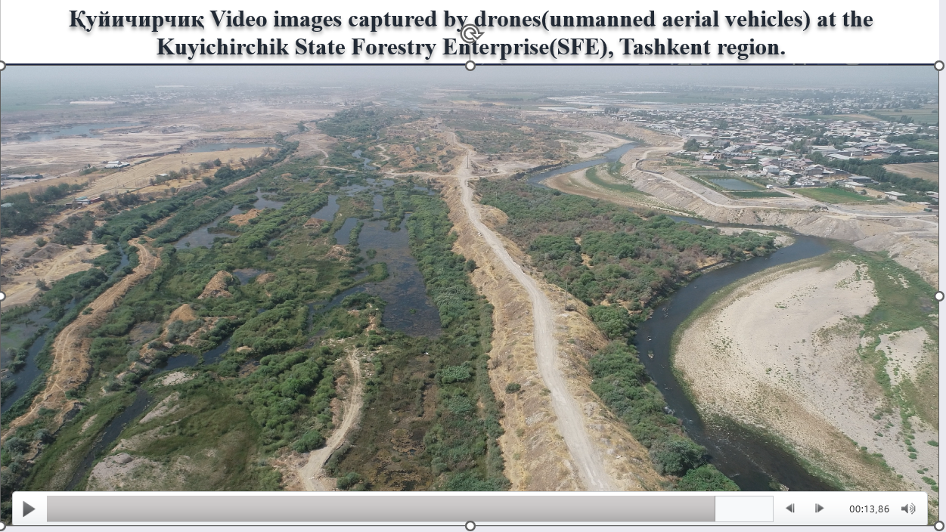

Slide 9
National Targets of Uzbekistan
O‘zbekistonning milliy rivojlanish maqsadlari
Forest area expanded to 6.1 million ha
Green areas increased to 30%
Protected areas expanded to 12%
  600,000 ha climate-protective green areas
  2.6 million ha restored (incl. 600,000 ha Aral seabed)
  26,200 ha protective forest plantations
  200 million seedlings annually
  +840 tonnes seed production
RESILAND CA+ Project
  • 226,500 ha under sustainable management
  • 500,000 beneficiaries (150,000 women)
  • 300,000 tCO₂e/year emission reduction
O‘rmon maydoni 6,1 million gektargacha kengaytirildi
Yashil hududlar 30% gacha oshirildi
Muhofaza etiladigan hududlar 12% gacha kengaytirildi
  600 000 gektar iqlimni himoya qiluvchi yashil hududlar
  2,6 million gektar tiklandi (jumladan, 600 000 gektar Orol dengizi tubi)
  26 200 gektar himoya o‘rmon plantatsiyalari
  Har yili 200 million ko‘chat yetishtiriladi
  +840 tonna urug‘ ishlab chiqarish
RESILAND CA+ loyihasi
  226 500 gektar barqaror boshqaruv ostida
  500 000 nafardan ortiq foydalanuvchilar (150 000 nafari ayollar)
  yiliga 300 000 tCO₂e emissiya kamayishi

Slide 10
Can These Targets Be Realistically Achieved?
Ushbu maqsadlarga real sharoitda erishish mumkinmi?
The process is closely overseen at the highest political level by
His Excellency President Shavkat Mirziyoyev.
At the operational level,
H.E. Mr. Aziz Abdukhakimov, Advisor to the President on Environmental Issues and Chairman of the National Committee for Ecology and Climate Change, personally coordinates the implementation of these efforts.
Furthermore, under the leadership of
Mr. Mukhitdinov Erkin Madorbekovich,
the Agency for Afforestation, Expansion of Green Areas and Combating Desertification operates with clearly defined mandates and responsibilities.
Rahbarlik va institutsional tuzilma
Jarayon eng yuqori siyosiy darajada
Janobi Oliylari Prezident Shavkat Mirziyoyev tomonidan bevosita nazorat qilinmoqda.
Amaliy darajada esa,
Janobi Oliylari Aziz Abduhakimov, Prezidentning ekologiya masalalari bo‘yicha maslahatchisi hamda Ekologiya va iqlim o‘zgarishi bo‘yicha milliy qo‘mita raisi, ushbu ishlarni bevosita muvofiqlashtirmoqda.
Shuningdek,
Mukhitdinov Erkin Madorbekovich rahbarligida
O‘rmonlashtirish, yashil hududlarni kengaytirish va cho‘llanishga qarshi kurashish agentligi aniq belgilangan vazifalar asosida faoliyat yuritmoqda.

Slide 11
Mevzuat-Sistem-Proje/
Qonunchilik – Tizim – Loyiha
These Presidential decrees and resolutions have established a strong legal and regulatory framework, while also creating a financial foundation based on national resources, with the RESILAND Project playing a leading role.
  11 September 2023 – DP-158 Uzbekistan – 2030 Strategy
  27 March 2024 – PP-140 On measures for the implementation of the RESILAND CA+: Uzbekistan Resilient Landscapes Restoration Project
  30 January 2025 – DP-16 State Program for the Implementation of Uzbekistan – 2030 Strategy
  30 May 2025 – DP-90 Yashil Makon (Green Space) National Programme
  30 May 2025 – PP-197 Institutional Framework for Afforestation and Desertification Control Agency
Ushbu Prezident farmonlari va qarorlari kuchli normativ-huquqiy bazani shakllantirdi hamda milliy manbalar asosida moliyaviy asos yaratildi, bunda RESILAND loyihasi yetakchi rol o‘ynamoqda.
  11 September 2023 – DP-158 O‘zbekiston – 2030 strategiyasi
  27 March 2024 – PP-140 RESILAND CA+: O‘zbekistonda barqaror landshaftlarni tiklash loyihasini amalga oshirish chora-tadbirlari to‘g‘risida
  30 January 2025 – DP-16 O‘zbekiston – 2030 strategiyasini amalga oshirish davlat dasturi
  30 May 2025 – DP-90 “Yashil makon” milliy dasturi
  30 May 2025 – PP-197 O‘rmonlashtirish va cho‘llanishga qarshi kurashish agentligining institutsional asoslari

Slide 12
My Professional Engagement in Uzbekistan and the Central Asian Region/
Ismoil Belen sifatida mening O‘zbekiston va Markaziy Osiyo mintaqasidagi faoliyatim
At the national level, I began my assignment on 22 December 2025 as an International Consultant under the RESILAND CA+ Project, focusing on forestry nursery systems. My responsibilities were later expanded to include contributions to the Forest Code.
At the regional level, my engagement includes:
  2013–2014 – Consultant, FAO Project-“Capacity Building for Sustainable Management of Mountain Watersheds in Central Asia and the Caucasus”
  2019 – Project Coordinator-“Restoration of Degraded Forest and Other Wooded Lands (FRIENDS)”
  2021–2022 – Team Leader-“Improving Biodiversity and Sustainable Forestry Projects”
  2023 – Team Coordinator-“Guidelines on Nature-based Solutions for Central Asia”
  2023 – Active participation in CRIC 21 (Samarkand)
  2024 – Guidelines Designer-“Ecosystem Restoration Guidelines for the Aral Sea Region” (FAO & UNDP)
  2024–2025 – Forestry Expert-Development of a regional forestry network
  2024–2025 – Team Coordinator-“Regional Guidelines on Value Chain Development and Market Access for NWFPs”
  2025 – Coordinator-Regional study visit (Samarkand & Kitob)
  2025–2027 (ongoing) – Senior Technical Expert, FAO
  “Regional Policy Brief on Forests and Food Security in Europe and Central Asia”
Milliy darajada, men 2025-yil 22-dekabr kuni RESILAND CA+ loyihasi doirasida Xalqaro maslahatchi sifatida faoliyatimni boshladim va asosan o‘rmon pitomnik tizimlari bilan shug‘ullandim. Keyinchalik mening vazifalarim kengaytirilib, O‘rmon kodeksiga ham hissa qo‘shish kiritildi.
Mintaqaviy darajada, mening faoliyatim 10 yildan ortiq davrni qamrab oladi va quyidagilarni o‘z ichiga oladi:
  2013–2014 – Maslahatchi, FAO loyihasi-“Markaziy Osiyo va Kavkazda tog‘li suv havzalarini barqaror boshqarish bo‘yicha salohiyatni oshirish”
  2019 – Loyiha koordinatori-“Degradatsiyaga uchragan o‘rmon va boshqa daraxtzor yerlarni tiklash (FRIENDS)”
  2021–2022 – Jamoa rahbari-“Biologik xilma-xillikni yaxshilash va barqaror o‘rmonchilik loyihalari”
  2023 – Jamoa koordinatori-“Markaziy Osiyo uchun tabiatga asoslangan yechimlar bo‘yicha qo‘llanma”
  2023 – CRIC 21 (Samarqand)da faol ishtirok
  2024 – Qo‘llanma ishlab chiquvchi-“Orol dengizi mintaqasi uchun ekotizimlarni tiklash bo‘yicha qo‘llanma” (FAO va UNDP)
  2024–2025 – O‘rmonchilik bo‘yicha ekspert-mintaqaviy o‘rmon tarmog‘ini rivojlantirish
  2024–2025 – Jamoa koordinatori-“NWFP bo‘yicha qiymat zanjiri va bozorga kirish bo‘yicha mintaqaviy qo‘llanma”
  2025 – Mintaqaviy o‘quv tashrifi koordinatori-(Samarqand va Kitob)
  2025–2027 (davom etmoqda) – FAO doirasida katta texnik ekspert
  “O‘rmonlar va oziq-ovqat xavfsizligi bo‘yicha Yevropa va Markaziy Osiyo uchun mintaqaviy siyosiy hujjat”

Slide 13
Key Contributions Under My Assignment in Uzbekistan/
O‘zbekistondagi faoliyatim doirasida nimalarga erishdim?
Under the RESILAND CA+ Project, my work focuses on system design, policy alignment, and implementation of modern forestry nursery systems in Uzbekistan.
Key deliverables include:
  Alignment Report with national policies and Uzbekistan–2030 Strategy
  RESILAND CA Nursery Framework (RNF) (standardized technical & institutional model)
  Pre-Establishment Nursery Questionnaire (data-driven planning tool)
  Activity Reports covering 9 pilot nurseries
Policy & legal contribution:
  Review of the Draft Forest Code (legal, technical, environmental assessment & recommendations)
International contribution:
  Information Note on the International Day of Forests (IDF)
RESILAND CA+ loyihasi doirasida mening faoliyatim O‘zbekistonda zamonaviy o‘rmon pitomnik tizimlarini loyihalash, siyosat bilan uyg‘unlashtirish va amaliyotga joriy etishga qaratilgan.
Asosiy natijalar:
  Milliy siyosatlar va “O‘zbekiston – 2030” strategiyasi bilan uyg‘unlashtirish hisobotı
  RESILAND CA Nursery Framework (RNF) (standart texnik va institutsional model)
  Pre-Establishment Nursery Questionnaire (ma’lumotlarga asoslangan rejalashtirish vositasi)
  Activity Reports 9 ta pilot pitomnik bo‘yicha
Siyosiy va huquqiy yo‘nalish:
  O‘rmon kodeksi loyihasini ko‘rib chiqish (huquqiy, texnik va ekologik tahlil va tavsiyalar)
Xalqaro darajada:
  Xalqaro o‘rmonlar kuni (IDF) bo‘yicha axborot hujjati

Slide 14
Nursery Visits and Website/Database Design
Ko‘chatxonaga tashriflar va veb-sayt/ma’lumotlar bazasi dizayni
Conducted two field missions (Dec 22–26, 2025 and Feb 1–14, 2026) in Uzbekistan
Held comprehensive meetings with institutional stakeholders
Visited and assessed all 9 state forest nurseries on-site
Data Collection & Technical Assessment:
  Verified survey data through field observations
  Collected detailed technical data: soil conditions, water resources, land structure, production infrastructure, accessibility, and environmental factors
  Conducted interviews with technical staff and field teams
  Developed a holistic evaluation of each nursery
Digital Platform Development:
  Designed a web-based collaborative platform:
  https://www.uzbeknursery.com
  Functions as a dynamic system for:
    Data storage and validation
    Technical reporting and analysis
    Expert input and stakeholder collaboration
Dissemination & Engagement:
  Initial findings presented to the Uzbekistan Forestry Agency (Feb 20, 2026)
  Comprehensive presentation delivered to the World Bank delegation and national stakeholders (Marc 2, 2026)
  Shared methodology, field results, and planning approach
O‘zbekistonda ikki marotaba dala tashriflari amalga oshirildi (2025-yil 22–26 dekabr va 2026-yil 1–14 fevral)
Tegishli muassasalar vakillari bilan keng qamrovli uchrashuvlar o‘tkazildi
Barcha 9 ta davlat o‘rmon ko‘chatxonalari joyida borib baholandi
Ma’lumot to‘plash va texnik baholash:
So‘rovnoma natijalari dala kuzatuvlari orqali tasdiqlandi
Quyidagi texnik ma’lumotlar yig‘ildi: tuproq xususiyatlari, suv resurslari, yer tuzilishi, ishlab chiqarish infratuzilmasi, kirish imkoniyati va ekologik omillar
Texnik mutaxassislar va dala jamoalari bilan suhbatlar o‘tkazildi
Har bir ko‘chatxona bo‘yicha kompleks (yaxlit) baholash ishlab chiqildi
Raqamli platforma ishlab chiqish:
Veb-asoslangan hamkorlik platformasi yaratildi:
https://www.uzbeknursery.com
Quyidagi funksiyalarni ta’minlaydi:
Ma’lumotlarni saqlash va tekshirish
Texnik hisobotlar va tahlil
Ekspert fikrlari va manfaatdor tomonlar hamkorligi
Natijalarni taqdim etish va hamkorlik:
Dastlabki natijalar O‘zbekiston O‘rmon xo‘jaligi agentligiga taqdim etildi (2026-yil 20-fevral)
Jahon banki delegatsiyasi va milliy manfaatdor tomonlarga keng qamrovli taqdimot o‘tkazildi (2026-yil 2-mart)
Metodologiya, dala natijalari va rejalashtirish yondashuvi taqdim etildi

Slide 15
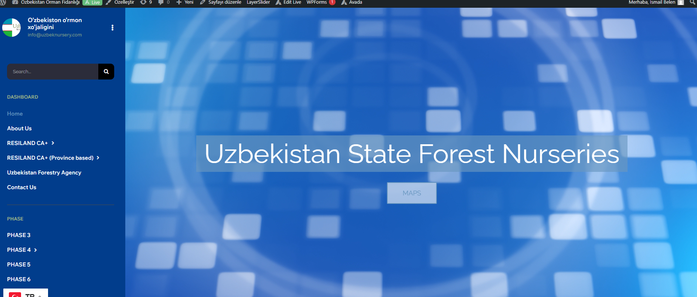
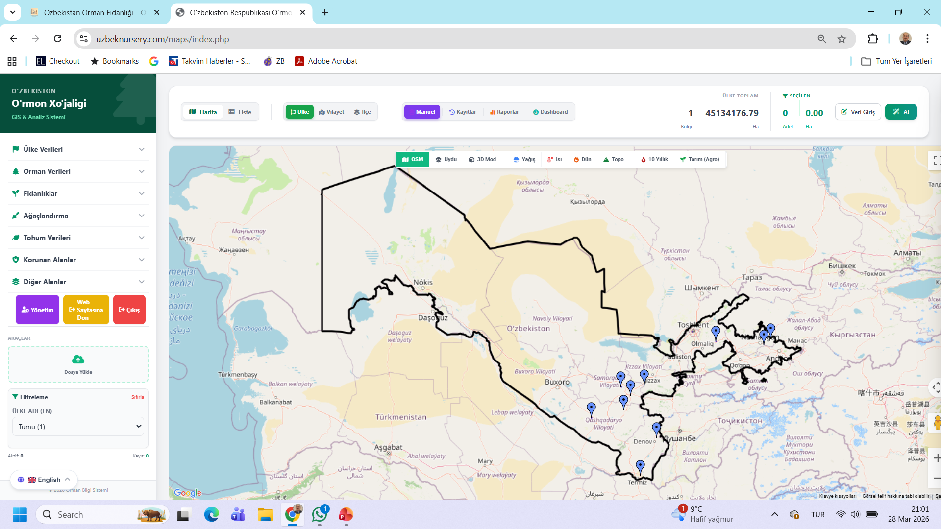
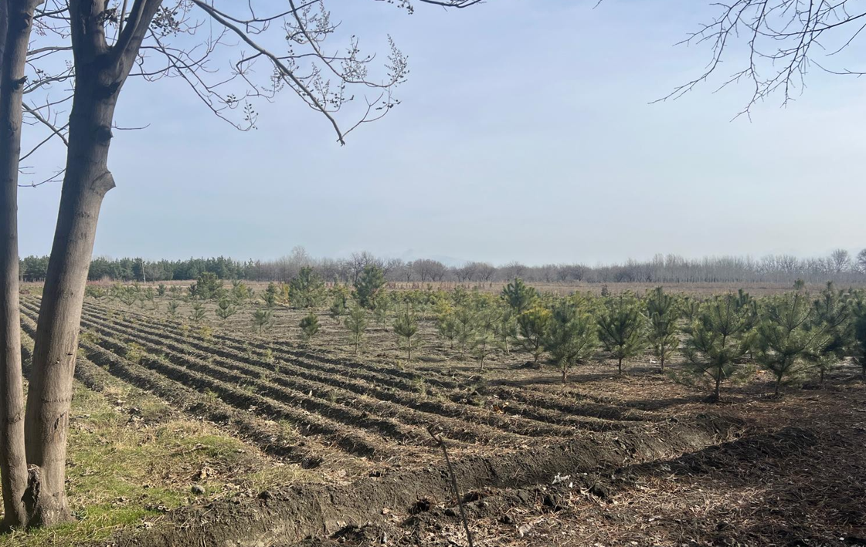
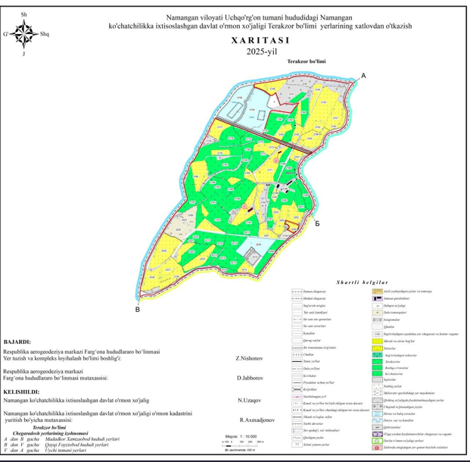
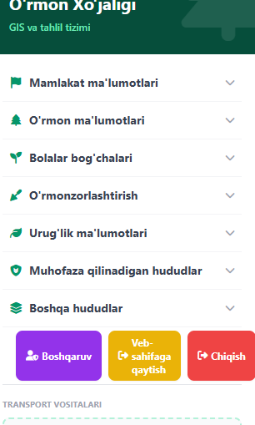

Slide 16
https://www.uzbeknursery.com/
Digital Platform Integration & Capabilities:
Designed for integration with multiple data sources, including national geospatial infrastructure
Enables combined analysis of field data and mapping systems
Satellite & Remote Sensing Integration:
Planned integration with Copernicus (Sentinel) satellites
Monitoring of land cover, drought, vegetation, and climate risks
Compatible with Google Earth and Collect Earth
Data-Driven Planning Support:
Utilizes ecological classification data for species selection and restoration planning
Can be integrated with Uzcosmos Smart Forestry Platform
AI-Based Decision Support (Future):
Species suitability analysis
Climate risk prediction
Nursery production optimization
Restoration prioritization
Conclusion:
A foundation for a data-driven, integrated digital forestry system in Uzbekistan beyond the 9 pilot nurseries
Raqamli platform integratsiyasi va imkoniyatlari:
Turli ma’lumot manbalari, jumladan milliy geoma’lumot tizimlari bilan integratsiya uchun ishlab chiqilgan
Dala ma’lumotlari va xaritalash tizimlarini birgalikda tahlil qilish imkonini beradi
Sun’iy yo‘ldosh va masofadan zondlash:
Copernicus (Sentinel) sun’iy yo‘ldoshlari bilan integratsiya rejalashtirilgan
Yer qoplami, qurg‘oqchilik, o‘simlik holati va iqlim xavflarini monitoring qilish imkoniyati
Google Earth va Collect Earth bilan mos ishlaydi
Ma’lumotga asoslangan rejalashtirish:
Ekologik tasniflash ma’lumotlari asosida tur tanlash va restavratsiya rejalashtirish
Uzcosmos Smart Forestry Platform bilan integratsiya qilish imkoniyati
Sun’iy intellekt (kelajak):
Tur mosligi tahlili
Iqlim xavflarini prognozlash
Ko‘chat ishlab chiqarishni optimallashtirish
Restavratsiya hududlarini ustuvorlashtirish
Xulosa:
Platforma 9 ta pilot ko‘chatxonadan tashqari, O‘zbekistonda raqamli va integratsiyalashgan o‘rmonchilik tizimining asosini yaratadi

Slide 17
Next Step/ Keyingi qadam
Phase 5 – Nursery Design: Preparation of Detailed Nursery Engineering Designs
Phase 6 – Technical Specifications & BoQ: Development of TechnicalSpecifications and Bills of Quantities
Phase 7 – Validation & Training: Second Field Mission for Technical Validation and Capacity Building
5-bosqich – Ko‘chatxona dizayni: Batafsil muhandislik loyihalarini tayyorlash
6-bosqich – Texnik spetsifikatsiyalar va BoQ (miqdorlar ro‘yxati): Texnik hujjatlar va miqdorlar hisobini ishlab chiqish
7-bosqich – Tasdiqlash va trening: Texnik tekshiruv va salohiyatni oshirish uchun ikkinchi dala missiyasi

Slide 18
Final Words-Yakuniy so‘zlar
Dear Colleagues, Dear Friends,
Despite facing arid and semi-arid conditions and the challenges of desertification, Uzbekistan also possesses a remarkable strategic advantage in its river systems and well-established irrigation infrastructure.
This creates significant opportunities for agroforestry, shelterbelts, river and canal corridor planting, and large-scale landscape restoration. When approached with integrated and forward-looking planning, this is not only an asset — it is a transformational opportunity.
What is taking place in Uzbekistan today is not merely a forestry initiative.
It is a long-term transformation process — one that brings together policy, institutions, science, technology, field implementation, and regional cooperation into a single, coherent and forward-looking system.
With more than 35 years of professional experience in this field, I can say with confidence that I have rarely seen such a clear alignment between vision, policy, and implementation.
I truly believe in the future of Uzbekistan.
I believe in its vision, its institutions, its people, and its capacity to deliver results.
A greener, more resilient, and more prosperous Uzbekistan is not only possible —
it is already in the making.
I wish this Forum every success.
Thank you very much.
Hurmatli hamkasblar, aziz do‘stlar,
Qurg‘oqchil va yarim qurg‘oqchil sharoitlar hamda cho‘llanish muammolariga qaramay, O‘zbekiston o‘zining daryo tizimlari va yaxshi shakllangan sug‘orish infratuzilmasi bilan muhim strategik ustunlikka ega.
Bu esa agroo‘rmonchilik, himoya o‘rmonzorlari (shelterbelt), daryo va kanallar bo‘ylab ko‘chat ekish hamda keng ko‘lamli landshaftni tiklash uchun katta imkoniyatlar yaratadi. Agar bu jarayon kompleks va uzoqni ko‘zlagan rejalashtirish asosida olib borilsa, bu nafaqat bir imkoniyat — balki tubdan o‘zgarish yaratadigan imkoniyatdir.
Bugun O‘zbekistonda amalga oshirilayotgan ishlar shunchaki o‘rmonchilik tashabbusi emas. Bu uzoq muddatli transformatsiya jarayoni bo‘lib, unda siyosat, institutlar, ilm-fan, texnologiya, amaliy ishlar va mintaqaviy hamkorlik yagona, uyg‘un va istiqbolga yo‘naltirilgan tizimga birlashmoqda.
Ushbu sohada 35 yildan ortiq professional tajribaga ega mutaxassis sifatida shuni ishonch bilan ayta olamanki, men kamdan-kam hollarda bunday aniq uyg‘unlikni — ya’ni qarash, siyosat va amaliyot o‘rtasidagi moslikni ko‘rganman.
Men O‘zbekistonning kelajagiga chin dildan ishonaman.
Men uning qarashiga, institutlariga, xalqiga va natijaga erishish salohiyatiga ishonaman.
Yashilroq, barqarorroq va farovonroq O‘zbekiston nafaqat mumkin — u allaqachon shakllanmoqda.
Ushbu Forumga katta muvaffaqiyat tilayman.
Katta rahmat.

