Slide 1
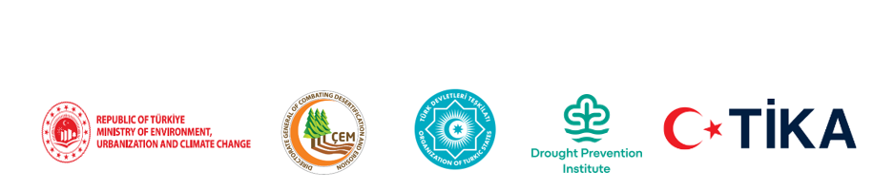
REGIONAL CAPACITY-BUILDING WORKSHOP ON RIO CONVENTIONS SYNERGIES
Dryland Forestry
and the Rio Synergy
İsmail Belen
28 July 2026 · Istanbul, Türkiye
Notes:
Open by greeting the OTS, TİKA, international organizations, scientists, civil society and private-sector representatives. Frame dryland forestry as a conversation about land, water, biodiversity, food, grazing, employment, health and future generations—not only trees.
[Sources]
- Provided source: 26 Temmuz 2026-Final-İsmail_Belen_TDT_Kurak_Alan_Ormanciligi_Rio_Sinerjisi_Konusma_Metni_Guncel(1).docx
- Provided source: OTS_Concept_Note_Agenda_EN-27-29 July 2026(1).docx
[/Sources]

Slide 2
OTS GREEN VISION · RIO CONVENTIONS SYNERGY
About İsmail Belen
Forest Engineer (MSc.) · Public Management Expert (MSc.)
1
2
3
EDUCATION
PUBLIC SERVICE
INTERNATIONAL & CIVIL SOCIETY
1991
BSc in Forest Engineering
1992–2002
Field forestry and technical posts
2010–2017
UNECE, EFC and FAO forestry assignments
2002
MSc in Applied Science
2003–2015
Administrative roles
2022–2026
UN Forum on Forests Bureau
2010
MSc in Public Management
2015–2022
Nature protection and national parks
Ongoing
Professional and civil-society organizations
2013
Harvard senior managers programme
2022–
Chief Inspector, General Directorate of Forestry
Experience spanning forestry practice, public administration and international cooperation.
01

Slide 3
OTS GREEN VISION · RIO CONVENTIONS SYNERGY
DROUGHT
DRYLAND
≠
A temporary period when rainfall and available water fall below normal.
A geography where water limitation is a permanent ecological feature.
If we confuse the two, every dryland looks like “empty land” — and every planting looks like “restoration.”
02
Notes:
Explain the distinction clearly. In the FAO framework, drylands include hyper-arid, arid, semi-arid and dry sub-humid zones with an aridity index of 0.65 or below. The practical consequence is that dryland forestry must begin with ecosystem diagnosis, not a planting target.
[Sources]
- FAO Global Dryland Assessment: https://www.fao.org/interactive/dryland-assessment/en/
- FAO Drylands, forests and agrosilvopastoral systems: https://www.fao.org/sustainable-forest-management-toolbox/modules/drylands-forests-and-agrosilvopastoral-systems/en
[/Sources]

Slide 4
OTS GREEN VISION · RIO CONVENTIONS SYNERGY
Drylands are a global system
This is not a marginal forestry issue; it is a global development system.
41%
>2B
1.1B ha
of the world’s land area
people depend on drylands
of forests lie in drylands
Dryland forests represent roughly 28% of the world’s forests.
Source: FAO Global Dryland Assessment
03
Notes:
Connect the numbers to policy. Drylands cover about 6.1 billion hectares, support more than two billion people and contain more than 1.1 billion hectares of forest. The message is not that all drylands should become forests; it is that global forest, food, climate and land policy cannot succeed without drylands.
[Sources]
- FAO Global Dryland Assessment: https://www.fao.org/interactive/dryland-assessment/en/
- FAO Dryland forests in a changing climate: https://www.fao.org/new-york/fao-statements/detail/dryland-forests-in-a-changing-climate--strategies-for-drought--dieback-and-tree-mortality/en
[/Sources]

Slide 5
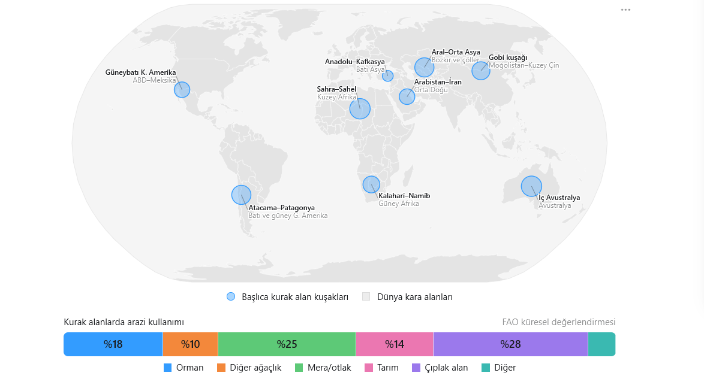

Slide 6
DRYLANDS · WATER · CIVILIZATION
Drylands are landscapes of civilization
Many cradles of civilization emerged in water-rich corridors within dry regions.
EARLY SETTLEMENTS
RIVER CIVILIZATIONS
OASIS & STEPPE NETWORKS
Upper Mesopotamia
& Central Anatolia
Tigris–Euphrates
& Nile
Transoxiana (Maveraünnehir) & Northern China
Communities at Göbekli Tepe and Çatalhöyük thrived where steppe met wetlands, foothills and rich food resources.
Floodplains and irrigation transformed seasonal water into agriculture, cities and institutions.
Oasis cities and the Yellow River–Loess transition linked drought-adapted farming with regional exchange.
Civilization did not flourish because of aridity. It flourished because people learned to manage scarce and variable water.
Notes:
Use this slide to make one careful distinction: major civilizations often emerged within today’s dryland belts, but usually in water-rich ecological niches—river valleys, floodplains, wetlands, oases and foothills. Historical climates also differed from present conditions, so a modern dryland map should not be presented as a palaeoclimate map.
[Sources]
- UNESCO, Göbekli Tepe: https://whc.unesco.org/en/list/1572/
- UNESCO, Neolithic Site of Çatalhöyük: https://whc.unesco.org/en/list/1405/
- Çatalhöyük Research Project, environmental context: https://www.catalhoyuk.com/site/rise_and_fall_of_a_neolithic_town
- Metropolitan Museum of Art, Mesopotamia 8000–2000 B.C.: https://www.metmuseum.org/toah/ht/02/wam.html
- British Museum, Early Egypt: https://www.britishmuseum.org/collection/galleries/early-egypt
- UNESCO, Silk Roads: Zarafshan–Karakum Corridor: https://whc.unesco.org/document/205746
- Cambridge University Press, Early agriculture in China: https://www.cambridge.org/core/books/cambridge-world-history/early-agriculture-in-china/B247CC47FB79573E34FE0558A3B3C441
[/Sources]

Slide 7
OTS GREEN VISION · RIO CONVENTIONS SYNERGY
From Rio to 2034: the global dryland policy architecture
Drylands now sit within a connected system of climate, biodiversity, land, forest and development commitments.
1992
2000
2017
2025
RIO EARTH SUMMIT
UNFF
UN FOREST PLAN
SAND & DUST DECADE
UNFCCC · CBD
Sustainable forest management
6 Global Forest Goals
2025–2034
1994
2015
2021
UNCCD
2030 AGENDA
RESTORATION DECADE
Desertification · drought
SDG 15.1 · 15.2 · 15.3
Prevent · halt · reverse
The direction is consistent: protect intact systems, restore degraded land and manage forests sustainably.
Sources: UNCCD Rio Conventions; SDG 15; A/RES/71/285; A/RES/73/284; A/RES/78/314
06

Slide 8
OTS GREEN VISION · RIO CONVENTIONS SYNERGY
2027–2030: the delivery window
2021
2025
2027
2030
2034
2036
UN Decade on Ecosystem Restoration
2021–2030
UN Decade on Sand and Dust Storms
2025–2034
UN Decade on Afforestation & Reforestation
2027–2036
07
Notes:
Explain why 2027–2030 is politically valuable: three UN implementation decades overlap, while 2026 highlights rangelands and pastoralists. This creates a common delivery window for ecosystems, sand and dust, forests, land, water and livelihoods. The opportunity is to align institutional calendars and funding pipelines—not merely to cite the decades.
[Sources]
- UNGA A/RES/73/284, UN Decade on Ecosystem Restoration: https://digitallibrary.un.org/record/3794317/files/A_RES_73_284-EN.pdf
- UNGA A/RES/78/314, UN Decade on Combating Sand and Dust Storms: https://digitallibrary.un.org/record/4054463/files/A_RES_78_314-EN.pdf
- UNGA A/RES/79/283, UN Decade on Afforestation and Reforestation: https://digitallibrary.un.org/record/4081511/files/A_RES_79_283-EN.pdf
- UNGA A/RES/76/253, International Year of Rangelands and Pastoralists 2026: https://digitallibrary.un.org/record/3965711
[/Sources]

Slide 9
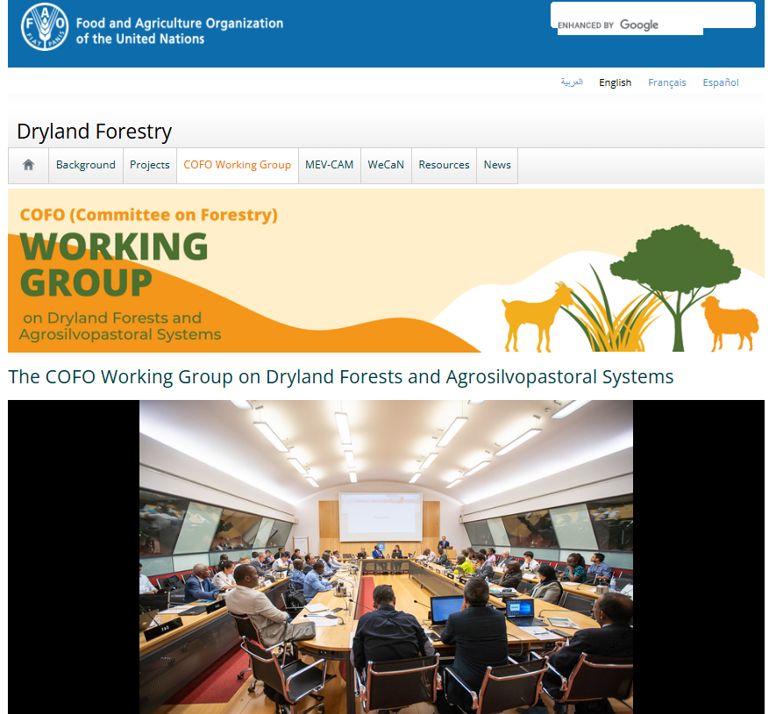
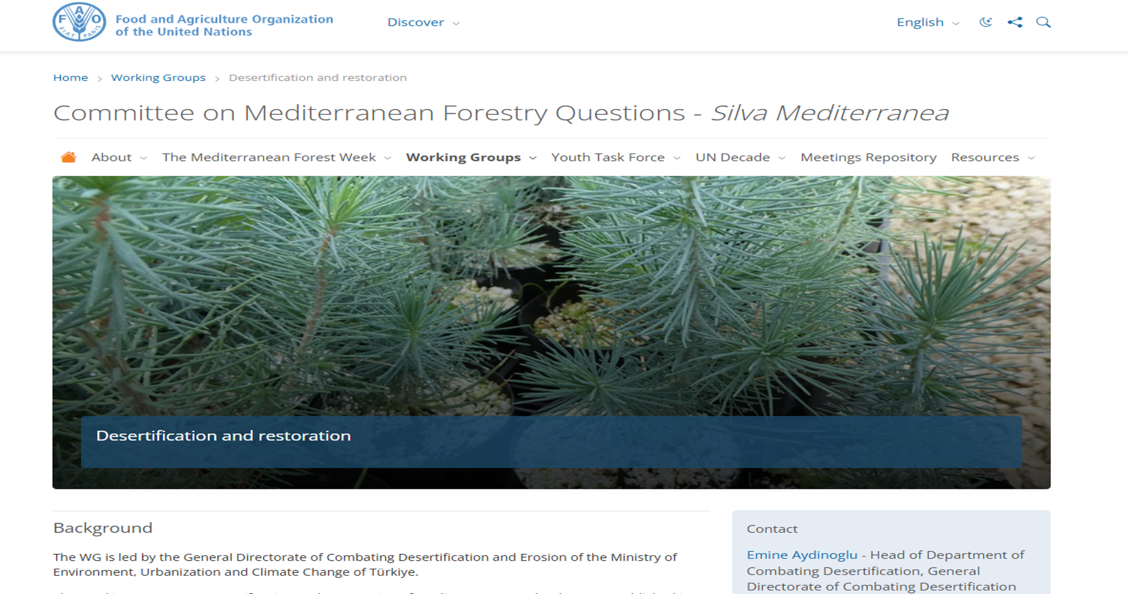

Slide 10
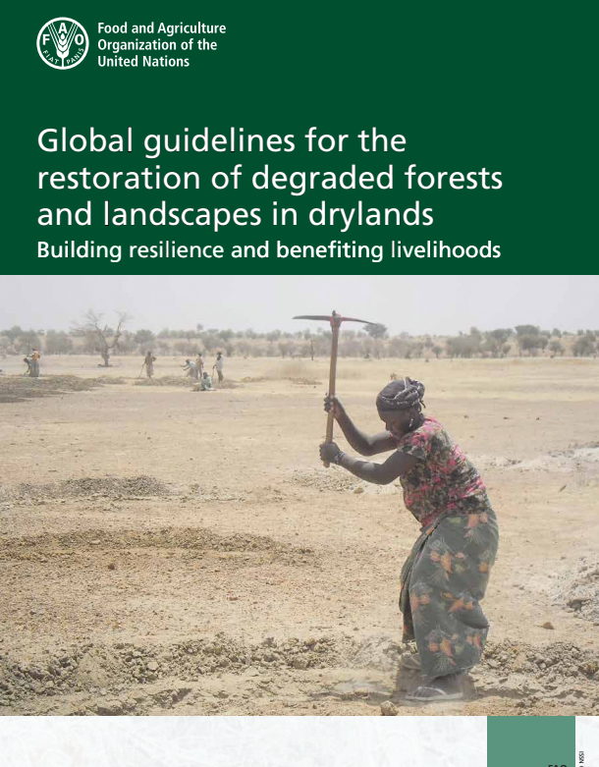
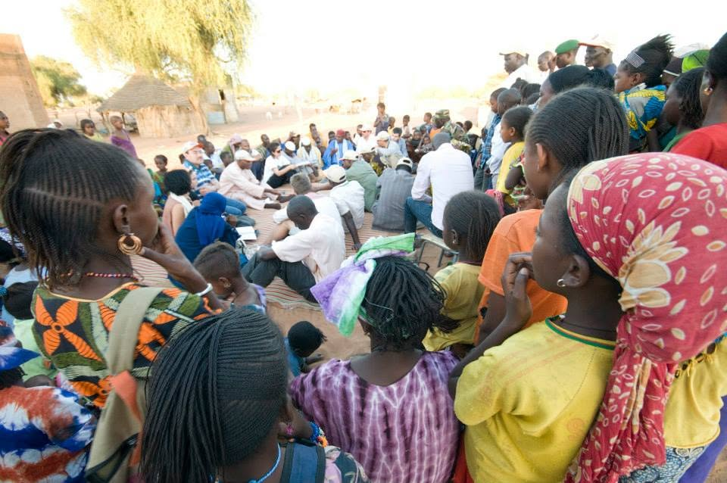
FAO — Global guidelines for restoration of degraded forests and landscapes in drylands: https://openknowledge.fao.org/items/95456dc4-c139-4771-9857-eb3c0e4ac7da

Slide 11
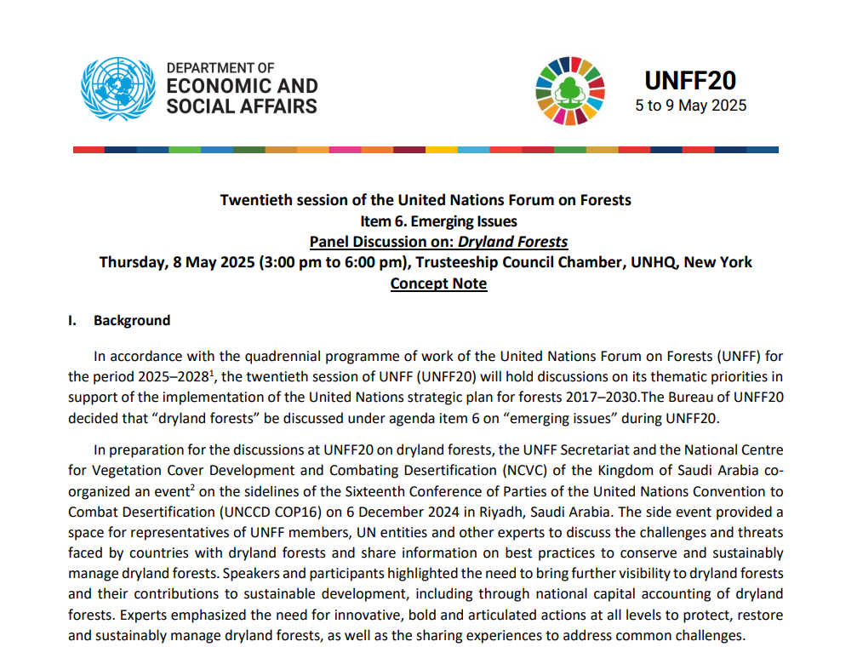
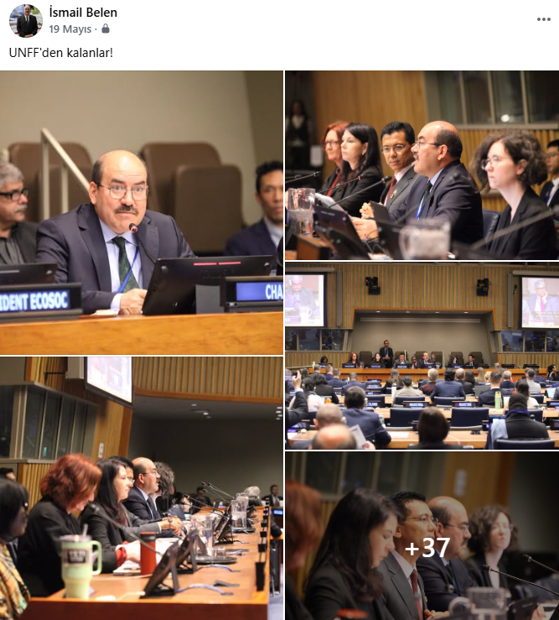
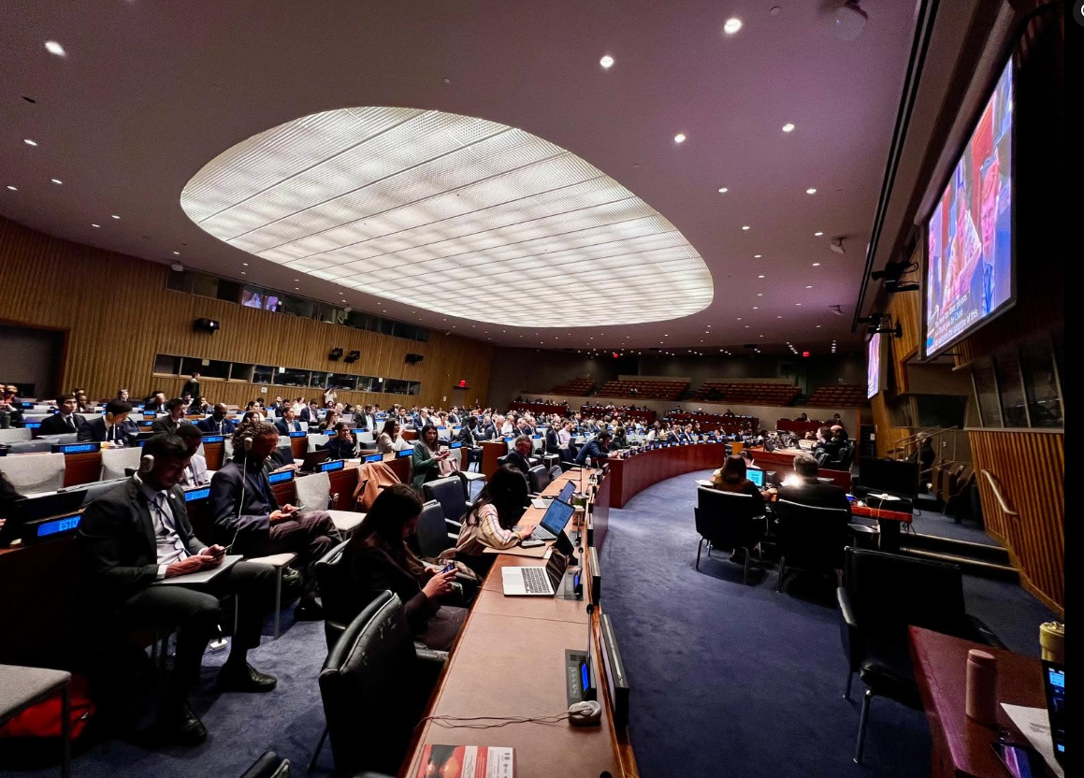

Slide 12
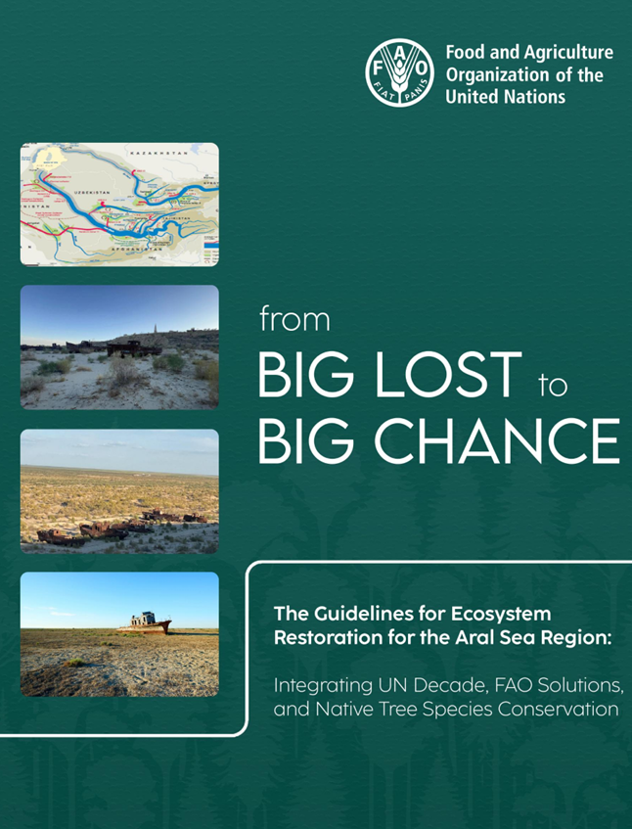
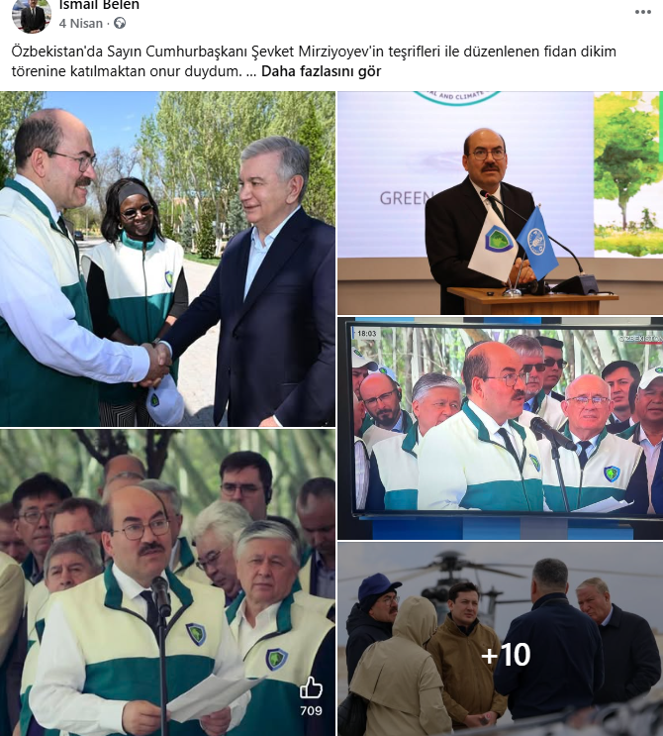

Slide 13
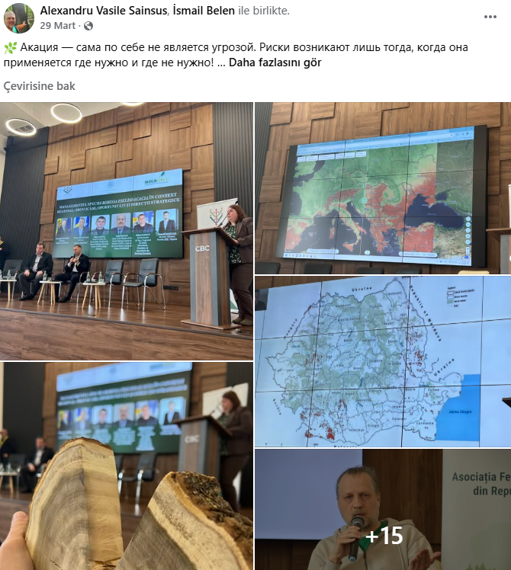
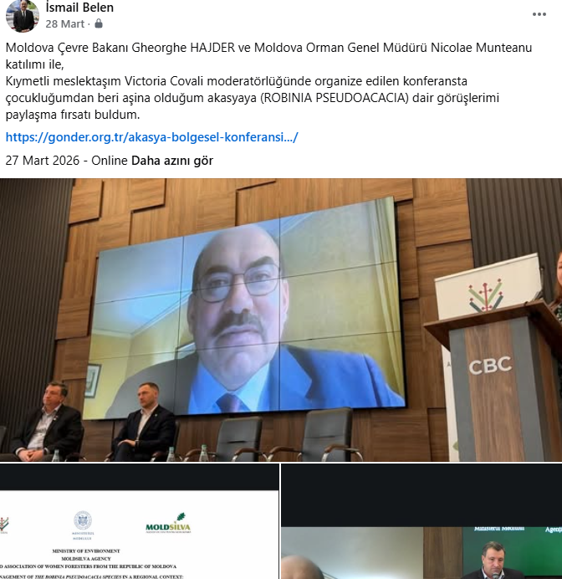

Slide 14
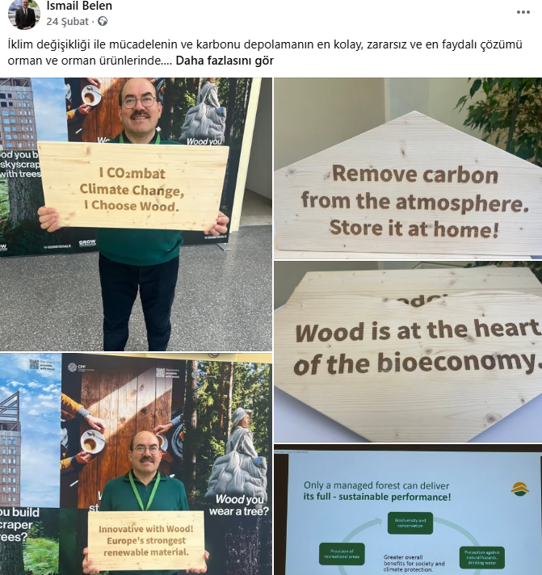
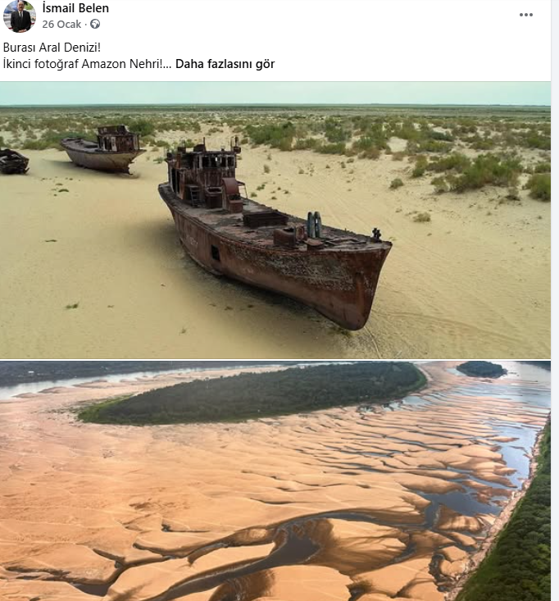

Slide 15
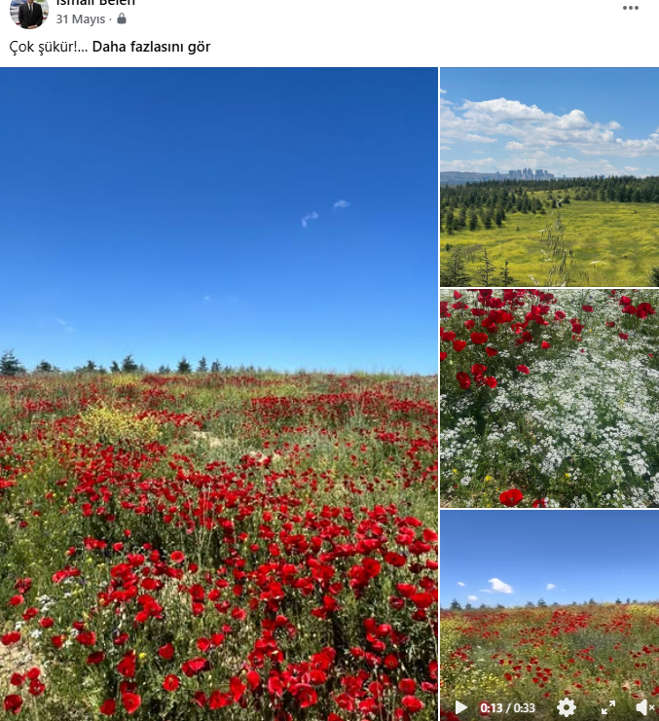
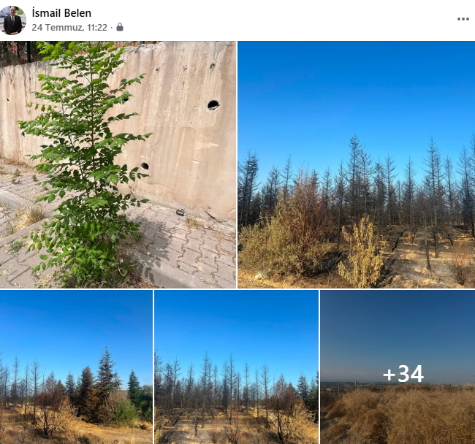

Slide 16
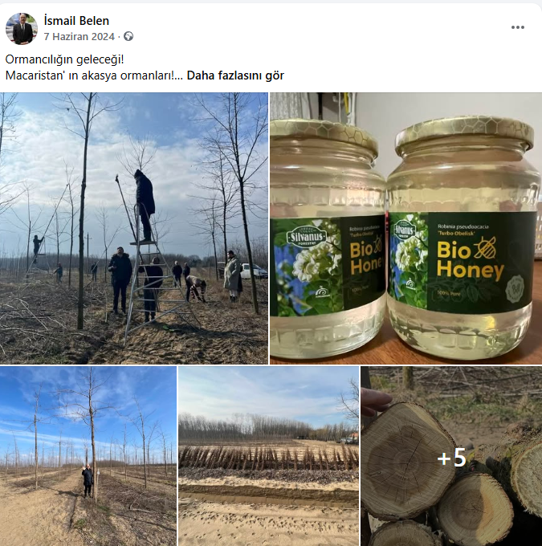
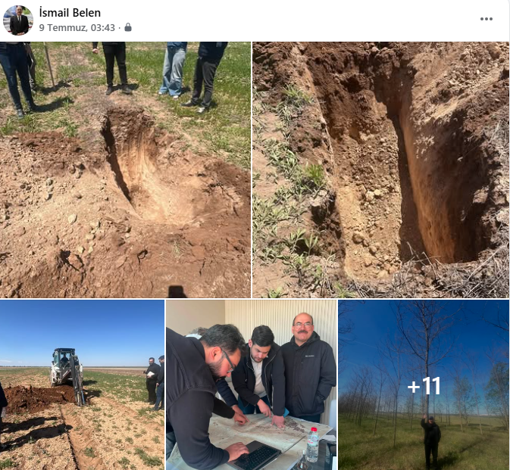

Slide 17
Aral Sea Ecosystem Restoration Guidelines
https://gonder.org.tr/wp-content/uploads/2026/01/The-Guidelines-for-Ecosystem-Restoration-for-the-Aral-Sea-Region-Integrating-UN-Decade-FAO-Solutions-and-Native-Tree-Species-Conservation-2024-FAO.pdf
A Next-Generation Nursery System for Green Uzbekistan
https://gonder.org.tr/a-next-generation-nursery-system-for-green-uzbekistan-16-march-2026/
Kırgızistan’da Ağaçlandırma Projesi Teklifi
https://gonder.org.tr/kirgizistanda-agaclandirma-projesi-teklifi/
Türk Dünyası Ormancılar Birliği Kurulmalı
https://gonder.org.tr/turk-dunyasi-ormancilar-birligi-kurulmali/
GÖNDER — Akasyalar Açarken / Robinia
https://gonder.org.tr/akasyalar-acarken/

Slide 18
OTS GREEN VISION · RIO CONVENTIONS SYNERGY
DPI can turn coordination into delivery
A programme unit—not another layer of institutions.
OTS + Ministers’ Mechanism
Political direction and the Green Vision
DPI PROGRAMME UNIT
Project preparation · partner matching · quality assurance · results reporting
NATIONAL FOCAL INSTITUTIONS
PILOT LANDSCAPE PORTFOLIO
FINANCE + DELIVERY
Technical ownership and data
Investment-ready projects
TİKA, FAO, UNDP, World Bank, private sector
The goal is a common results framework—not a new bureaucracy.
08
Notes:
Present DPI as the central programme unit for dryland forestry and restoration investments across OTS countries. Political guidance comes from OTS and the ministers’ mechanism; technical ownership remains with national institutions; delivery comes from universities, research institutions, private sector and local communities; finance comes from national budgets and development partners.
[Sources]
- OTS Cooperation among Ministers of Environment and Ecology: https://www.turkicstates.org/en/areas-of-cooperation-detail/26-cooperation-among-the-ministers-of-environment-and-ecology
- OTS Drought Prevention Institute call: https://turkicstates.org/en/news/the-first-international-call-for-expression-of-interest-of-the-drought-prevention-institute-dpi-of-the-organization-of-turkic-states-
- Provided Final speech document, section 6: proposed DPI-centered implementation architecture.
[/Sources]

