Slide 1
Modern Forest Nursery
System in Uzbekistan
1 August 2026
İsmail BELEN

Slide 2
Purpose of the Presentation
This presentation provides management with a comprehensive overview of the work completed and the activities planned under Contract No. LRP/IC/08, signed between the Project Management Unit of the Uzbekistan Resilient Landscapes Restoration Project and International Consultant Mr. Ismail Belen.
The contract covers the technical assessment, feasibility studies, detailed design, upgrading and preparation of nine forestry nurseries in Uzbekistan.
Key Objectives
  Present the activities and technical deliverables completed under the contract
  Report the current status and results achieved for the nine forestry nurseries
  Present the institutional approvals and developments following the stakeholder consultations
  Outline the remaining contractual activities, management decisions and next steps required for implementation

Slide 3
Work Completed to Date
Field assessments and feasibility studies were completed for all nine forestry nurseries.
The Forestry Agency invited the management authorities responsible for the nine nurseries to the coordination and stakeholder consultation meeting held at GREEN University on 9 July 2026.
Following the meeting, written proposals, technical requirements, confirmations and consents were received from all nine forestry enterprises.
Based on this first round of feedback, the Phase 6 documents were revised and resubmitted on 13 July 2026.
The revised documents were subsequently circulated to the nine forestry enterprises for a second round of review, and their final confirmations and consents were obtained.
In accordance with these approvals, the Second Revised Phase 6 – Technical Specifications, Bills of Quantities and Cost Estimates Package for the Nine Forestry Nurseries was submitted by International Consultant Ismail Belen on 17 July 2026.
The Forestry Agency formally accepted the Second Revised Phase 6 package and transmitted it to the PIU through its official letter No. 01/32-4110 dated 23 July 2026.

Slide 4
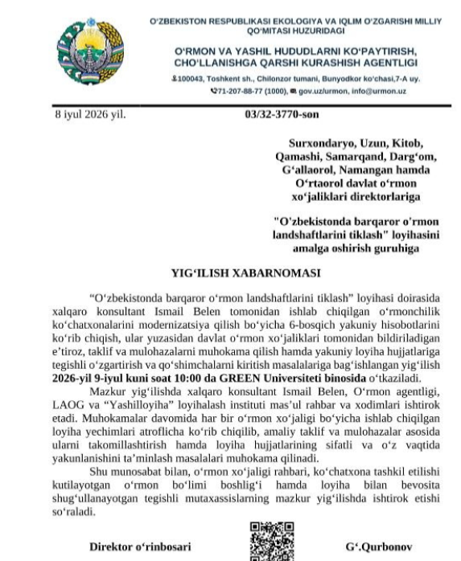
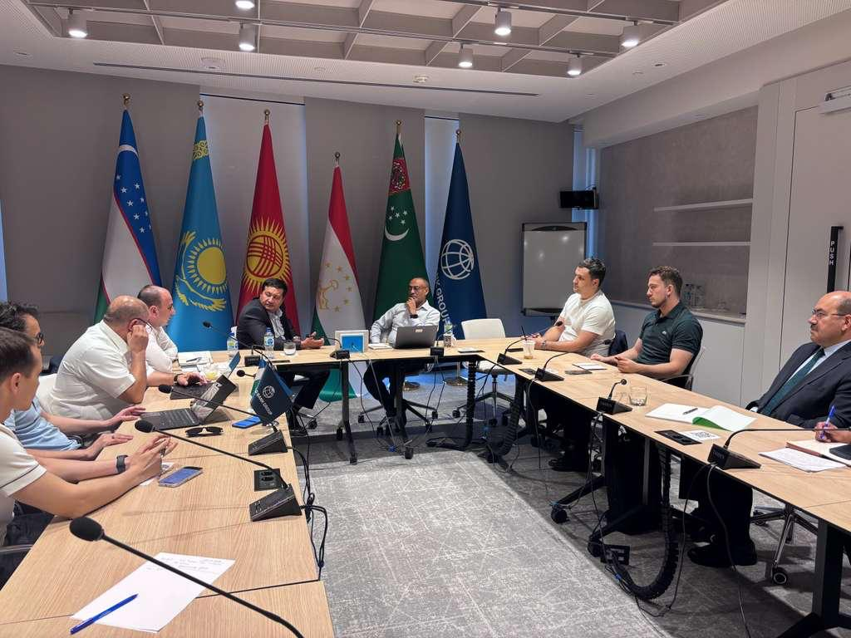
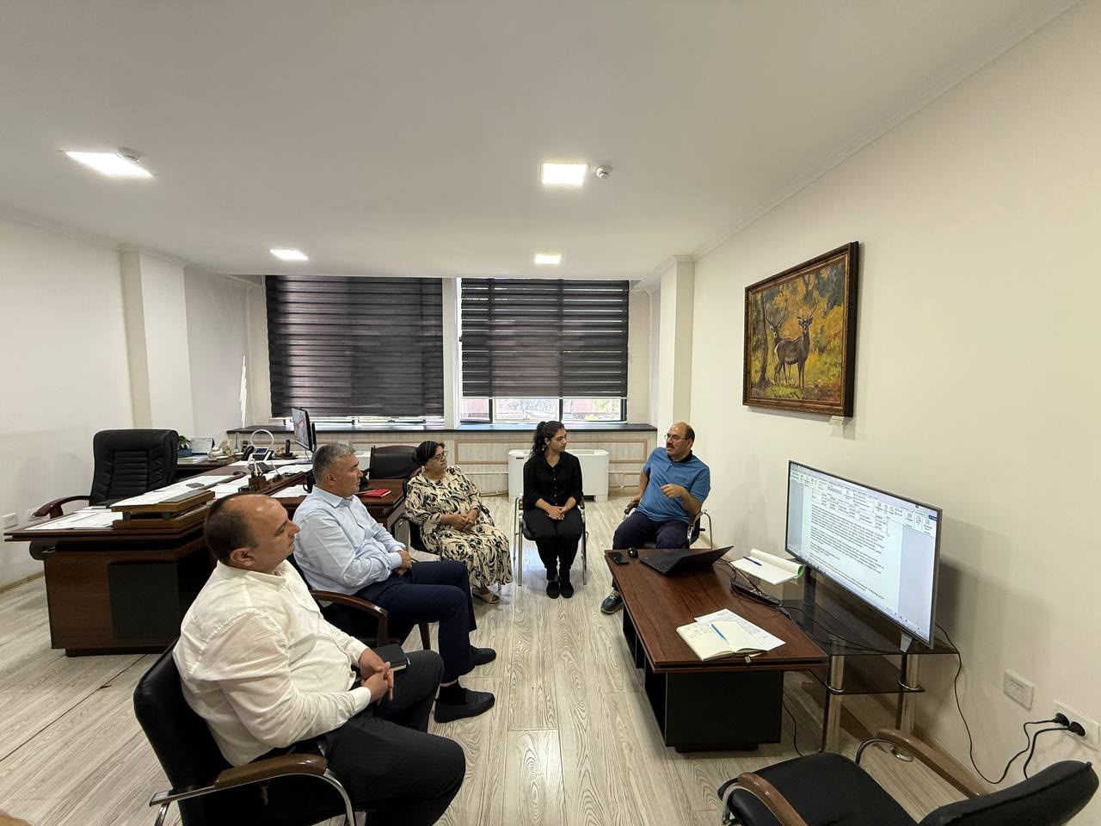
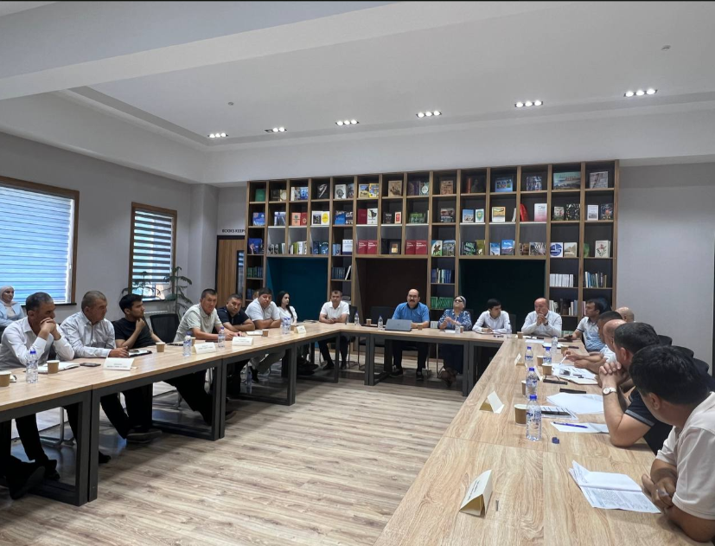

Slide 5
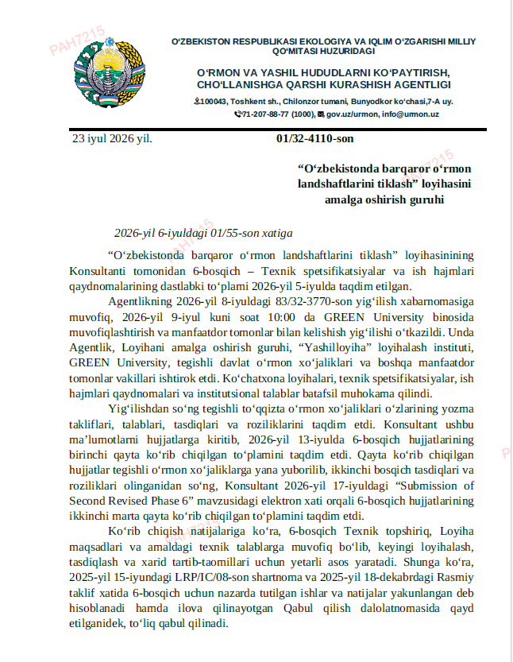
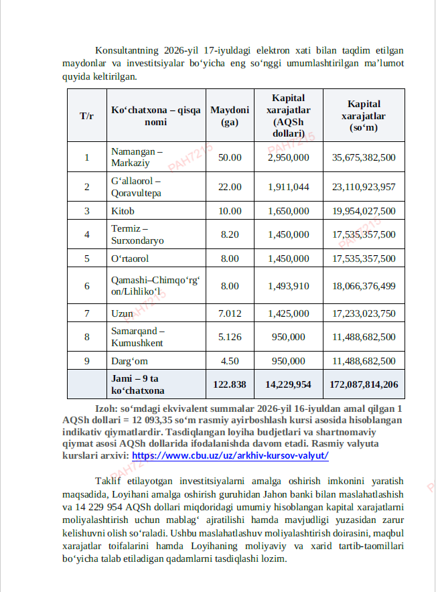

Slide 6
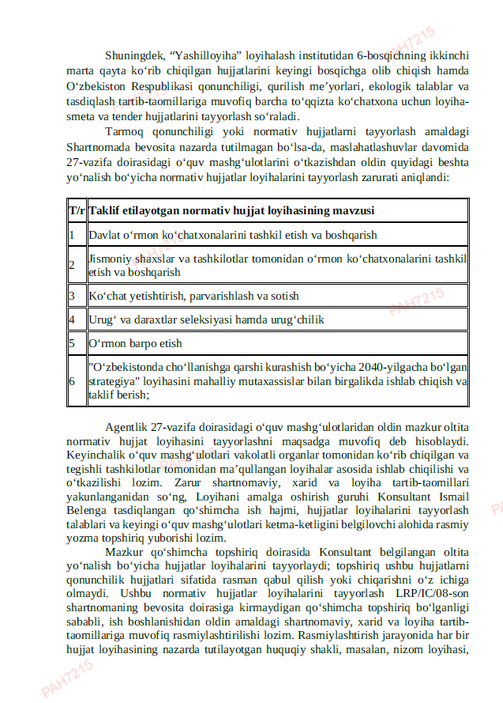
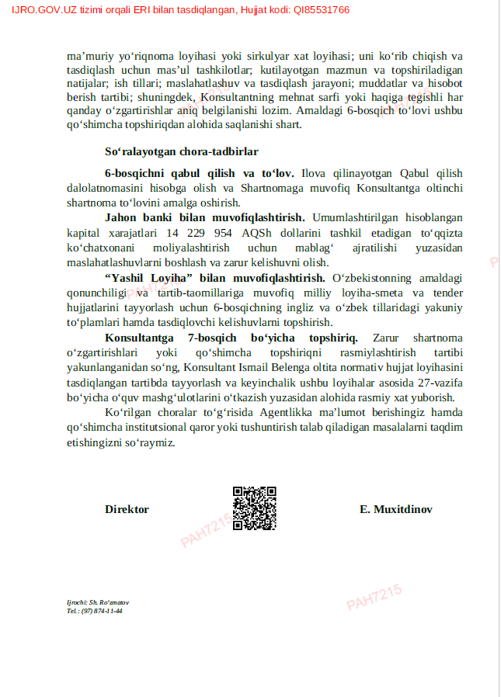

Slide 7
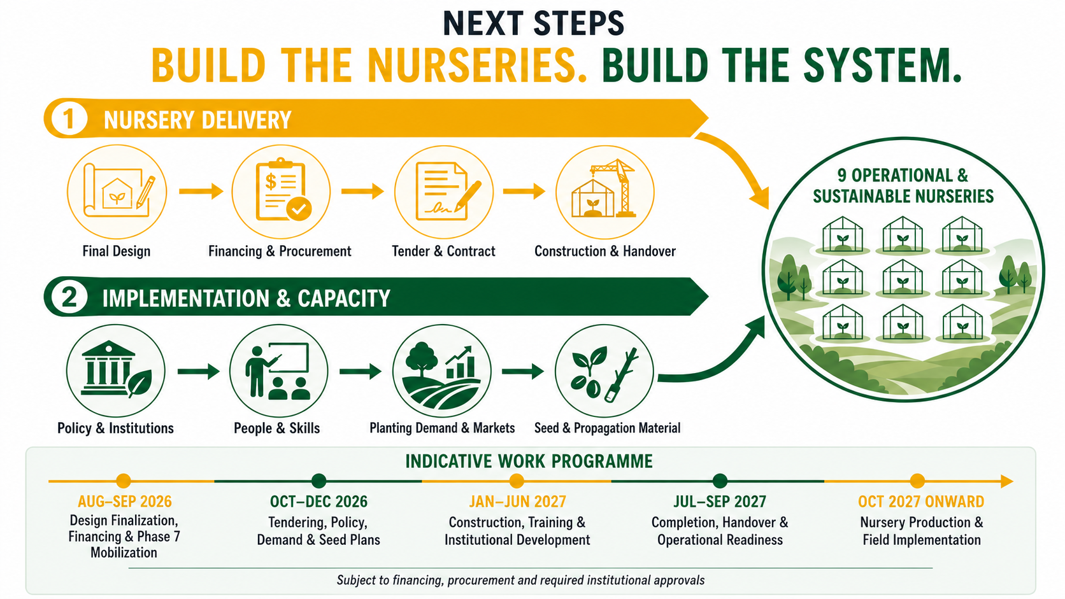
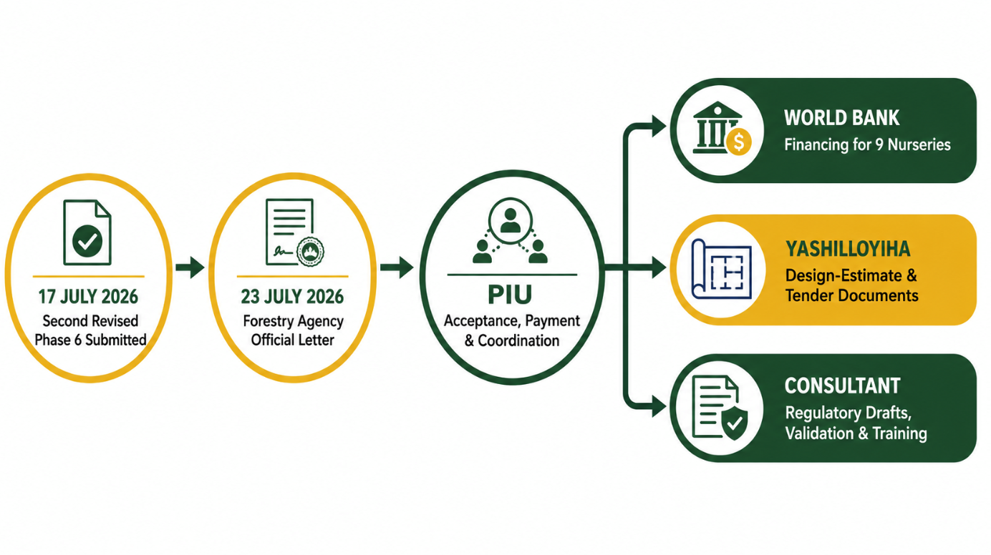

Slide 8
NEXT STEPS-Nursery Construction and Implementation – Capacity Development-1. NURSERY CONSTRUCTION
Final Design and Tender Documentation
• Yashilloyiha Design Institute will complete the national Design and Estimate Documentation, technical specifications, Bills of Quantities, cost estimates and tender documents for all nine nurseries.
• The Forestry Agency and the PIU will review and approve the technical scope before procurement.
Financing and Procurement Planning
• The PIU, on behalf of the Forestry Agency, will finalize financing arrangements with the World Bank and update the Project Procurement Plan.
• All procurement transactions will be managed by the PIU through the World Bank’s STEP system.
Tendering and Contract Award
• The Forestry Agency will act as the Project Implementing Agency and Employer.
• The PIU Procurement Team will conduct the tender on behalf of the Forestry Agency, coordinate bid opening and technical evaluation, prepare the evaluation report and obtain the World Bank’s no-objection where required.
• Following approval of the evaluation results, the construction contracts will be awarded and signed under the authorized project arrangements.
Construction, Supervision and Handover
• Selected contractors will construct the nurseries in accordance with the approved designs, contracts and environmental and social requirements.
• The PIU will manage the contracts, payments, safeguards, monitoring and reporting.
• Completed nurseries will be inspected, formally accepted and handed over to the responsible forestry enterprises for operation.

Slide 9
NEXT STEPS-Nursery Construction and Implementation – Capacity Development-2. IMPLEMENTATION AND CAPACITY DEVELOPMENT
Policy and Institutional Development
• The Forestry Agency will lead the preparation of the required nursery, seed, planting-material, afforestation and private-sector regulations.
• The PIU will formalize the additional assignment and issue written instructions to International Consultant Mr. Ismail Belen.
Human and Institutional Capacity
• Training programmes will be developed for nursery managers, technical staff, forestry enterprises, communities and private producers.
• Activities will include technical training, training of trainers, on-the-job training, study visits, international workplace training and operational management support, subject to approved work plans and budgets.
Planting Demand and Market Planning
• Afforestation, rehabilitation, agroforestry, protective planting and commercial planting areas will be identified and developed into annual planting programmes.
• Demand, market opportunities, private-sector participation and potential export requirements will be assessed before full-scale nursery production begins.
Seed and Propagation Material Planning
• Seed sources, provenances, seed orchards, superior trees, grafting material, mother plantations and seed-bank requirements will be identified and registered.
• Species, quantities and production schedules will be matched with ecological site classifications and approved planting programmes.
THE CONSTRUCTION AND CAPACITY-DEVELOPMENT WORKSTREAMS MUST PROCEED IN PARALLEL.

Slide 10
